Slide 1



Slide 2



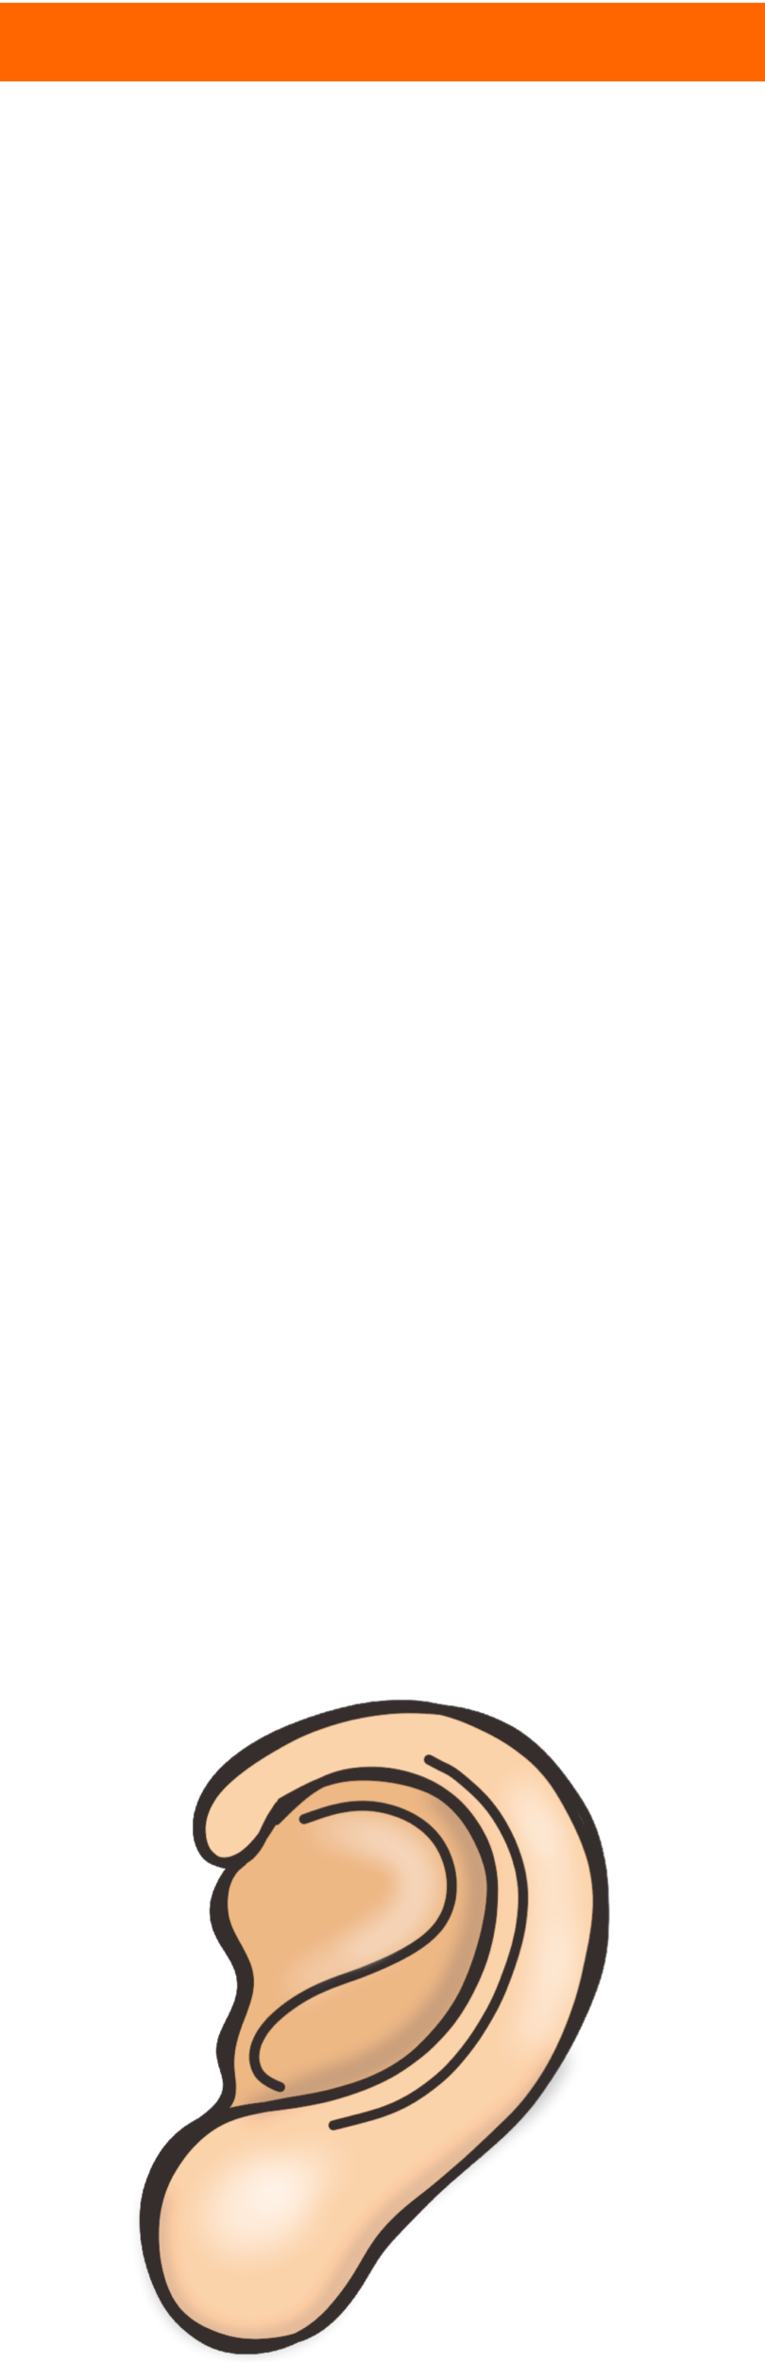

What are the five main human senses?
Humans (us!) have five main senses.
Can you say which part of the body is associated with each sense?
sight
hearing
taste
touch
smell

Slide 3
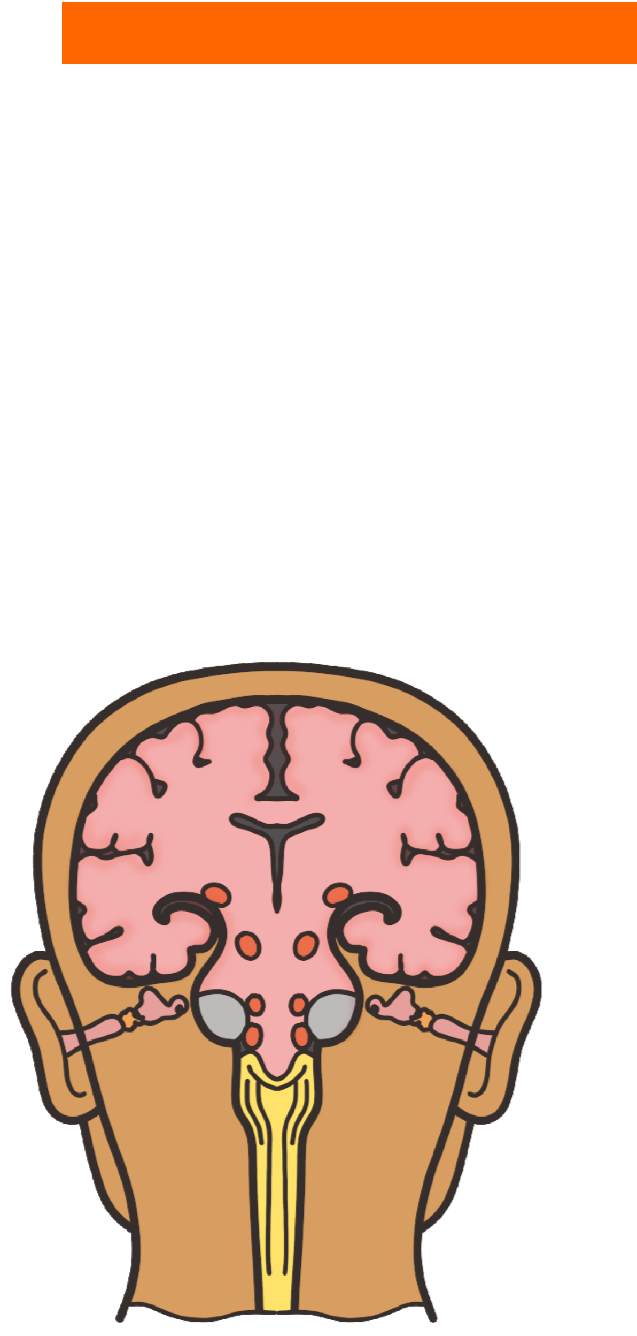
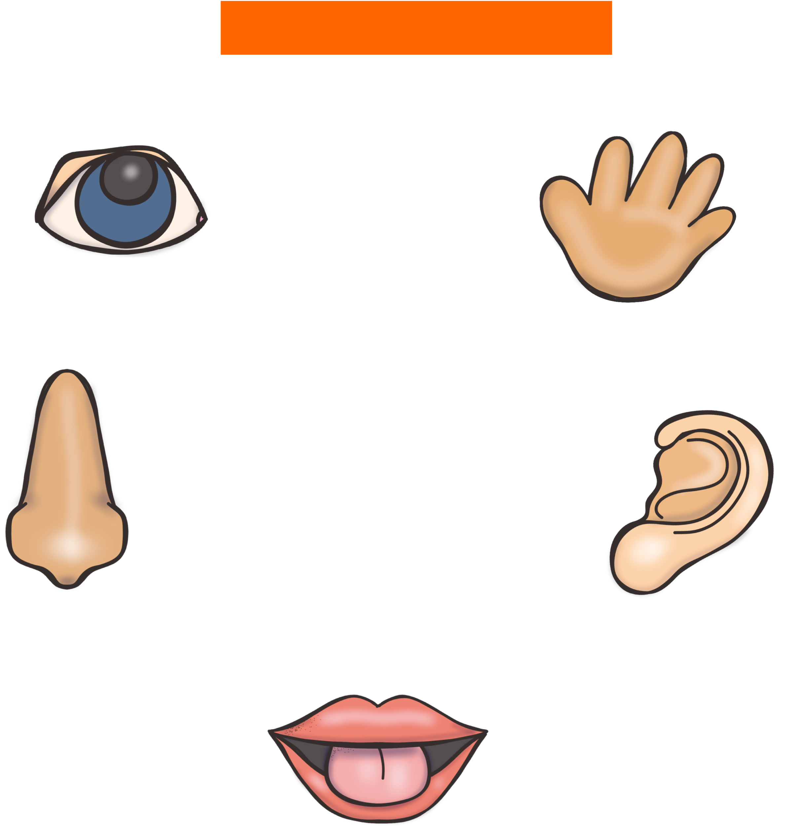
How do our senses work?
Our eyes, ears, tongue, skin and nose are our sensory organs.
Each of these organs collect and send information to our brains to help us understand the world.

Slide 4


Sight
The sense of sight uses our eyes.
eyes
Our eyes use light to help us see.
What can you see right now?

Slide 5

Hearing
The sense of hearing uses our ears.
ears
Sounds travel to our ears through the air and cause the inside of our ear to vibrate.
What can you hear right now?

Slide 6


Taste
tongue
The sense of taste uses our tongue.
Our tongue is covered in taste buds which tell the brain what kind of flavours are being tasted.
What was the last thing you tasted?

Slide 7

Touch
skin
The sense of touch uses our skin.
Our skin covers our whole body and we use it to feel texture, shape, temperature and other properties.
Touch a part of your clothing.
What does it feel like?
Rough, smooth, scratchy, soft?

Slide 8

Smell
nose
The sense of smell uses our nose.
Small invisible scent particles travel through the air and into our nose.
Can you smell anything right now? What is your favourite smell?

Slide 9
Quick Quiz!
For each body part labelled, say what sense is connected to that body part.
eyes
ears
Sight
Hearing
tongue
nose
Taste
skin
Smell
Touch

