Slide 1





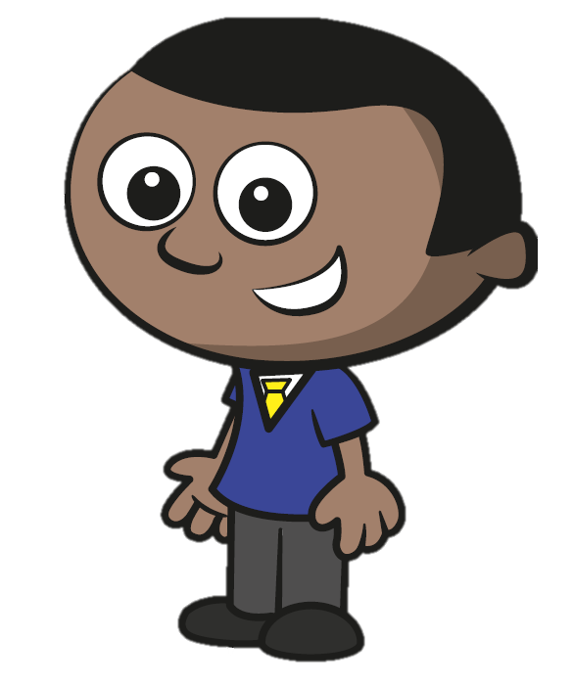
Year 1 | Week 1 | Day 1
1) How many pears?
  2) How many fingers?
  3) Who is taller?
4) 1, 2, 3, 4,
Mo
Eva

Slide 2
Year 1 | Week 1 | Day 1
1) How many pears?
  2) How many fingers?
  3) Who is taller?
4) 1, 2, 3, 4,
4
3
Eva
5
Mo
Eva

Slide 3

Year 1 | Week 1 | Day 2
1) How have the shapes been sorted?
2) How many fingers?
3) Who is shorter?
4) 5, 4, 3, 2,
Mo
Eva

Slide 4
Year 1 | Week 1 | Day 2
1) How have the shapes been sorted?
2) How many fingers?
3) Who is shorter?
4) 5, 4, 3, 2,
By shape
2
Mo
Mo
Eva
1

Slide 5

Year 1 | Week 1 | Day 3
1) How have the shapes been sorted?
2) How many apples?
3) Which line is longer?
4) 1, 2, , 4, 5
A
B

Slide 6
Year 1 | Week 1 | Day 3
1) How have the shapes been sorted?
2) How many apples?
3) Which line is longer?
4) 1, 2, , 4, 5
By colour
3
A
A
B
3

Slide 7
Year 1 | Week 1 | Day 4
1) Complete the number track.
2) How many pears?
3) Which line is shorter?
4) 5, , 3, 2, 1
1 | 2 | 3 | 4 | 5 | 6 | 7 | 8 | 9
A
B

Slide 8
Year 1 | Week 1 | Day 4
1) Complete the number track.
2) How many pears?
3) Which line is shorter?
4) 5, , 3, 2, 1
1 | 2 | 3 | 4 | 5 | 6 | 7 | 8 | 9
10
2
B
A
B
4

Slide 9


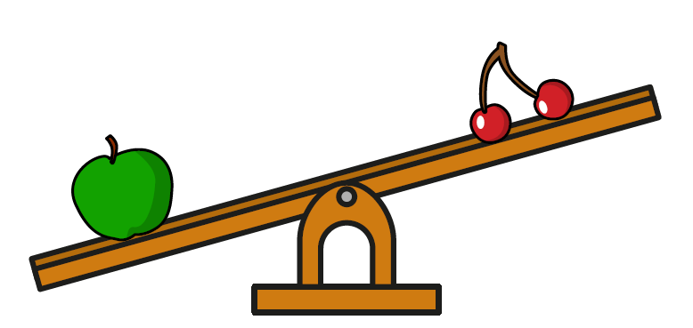
Year 1 | Week 1 | Day 5
1) How many cars?
2) How many bananas?
3) Which is heavier?
4) 0, 1, 2, 3,

Slide 10
Year 1 | Week 1 | Day 5
1) How many cars?
2) How many bananas?
3) Which is heavier?
4) 0, 1, 2, 3,
7
3
The apple
4

Slide 11

Year 1 | Week 2 | Day 1
1) How many pencils?
2) How many apples?
3) Which is lighter?
4) 4, 3, 2, 1,

Slide 12
Year 1 | Week 2 | Day 1
1) How many pencils?
2) How many apples?
3) Which is lighter?
4) 4, 3, 2, 1,
9
4
The cherry
0

Slide 13


Year 1 | Week 2 | Day 2
1) How many sweets are circled?
2) How have the shapes been sorted?
3) Which is heavier?
4) How many cubes?

Slide 14
Year 1 | Week 2 | Day 2
3
1) How many sweets are circled?
2) How have the shapes been sorted?
3) Which is heavier?
4) How many cubes?
By shape
The rubber
3

Slide 15


Year 1 | Week 2 | Day 3
1) Draw counters to show how many flowers there are.
2) How have the objects been sorted?
3) Which is lighter?
4) How many cubes?

Slide 16
Year 1 | Week 2 | Day 3
1) Draw counters to show how many flowers there are.
2) How have the objects been sorted?
3) Which is lighter?
4) How many cubes?
By fruit
The pencil
2

Slide 17



Year 1 | Week 2 | Day 4
1) Draw one counter for each bee.
2) Complete the number track.
3) Which glass is full?
4) What is the number?
1 | 2 | 3 | 4 | 5 | 6 | 7
A B C

Slide 18
Year 1 | Week 2 | Day 4
1) Draw one counter for each bee.
2) Complete the number track.
3) Which glass is full?
4) What is the number?
1 | 2 | 3 | 4 | 5 | 6 | 7
8
B
A B C
4

Slide 19
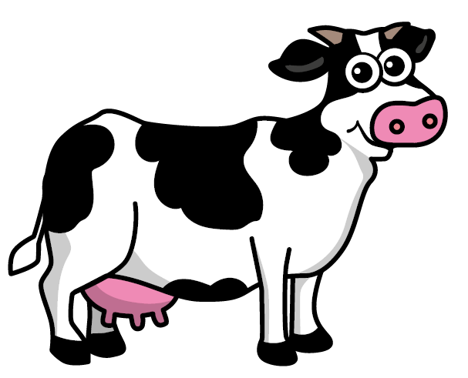
Year 1 | Week 2 | Day 5
1) Which word matches the number 9?
2) How many cows?
3) Which glass is empty?
4) How many counters?
nine eight seven
A B C

Slide 20
Year 1 | Week 2 | Day 5
1) Which word matches the number 9?
2) How many cows?
3) Which glass is empty?
4) How many counters?
nine eight seven
6
C
A B C
4

Slide 21




Year 1 | Week 3 | Day 1
1) What comes next?
2) How many sheep?
3) How many strawberries?
4) How many?

Slide 22

Year 1 | Week 3 | Day 1
1) What comes next?
2) How many sheep?
3) How many strawberries?
4) How many?
10
5
5

Slide 23

Year 1 | Week 3 | Day 2
6, 7, 8,
2) How many pencils are circled?
3) How have the shapes been sorted?
4) How many?

Slide 24
Year 1 | Week 3 | Day 2
6, 7, 8,
2) How many pencils are circled?
3) How have the shapes been sorted?
4) How many?
9
5
By colour
3

Slide 25

Year 1 | Week 3 | Day 3
1) One more than 5 is
2) Draw one counter for each cow.
3) How have these shapes been sorted?
4) How many?

Slide 26
Year 1 | Week 3 | Day 3
1) One more than 5 is
2) Draw one counter for each cow.
3) How have these shapes been sorted?
4) How many?
6
By shape
2

Slide 27




Year 1 | Week 3 | Day 4
1) What comes next?
2) Draw counters to show the number of sweets.
3) Complete the number track.
4) How many?
1 | 2 | 3 | 4 | 5 |  | 7 | 8 | 9

Slide 28
Year 1 | Week 3 | Day 4
1) What comes next?
2) Draw counters to show the number of sweets.
3) Complete the number track.
4) How many?
1 | 2 | 3 | 4 | 5 |  | 7 | 8 | 9
6
10
4

Slide 29


Year 1 | Week 3 | Day 5
1) 10, 9, 8,
2) Match the counters to the correct number.
How many flowers are there?
4) How many?
five six seven

Slide 30
Year 1 | Week 3 | Day 5
7
1) 10, 9, 8,
2) Match the counters to the correct number.
How many flowers are there?
4) How many?
five six seven
8
5

Slide 31
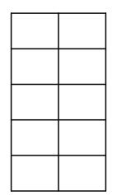




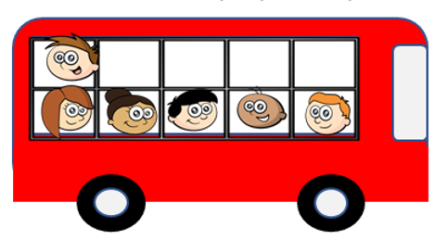






Year 1 | Week 4 | Day 1
1) One less than 8 is
2) What comes next?
3) How many socks?
4) How many children are
on the bus?

Slide 32
Year 1 | Week 4 | Day 1
1) One less than 8 is
2) What comes next?
3) How many socks?
4) How many children are
on the bus?
7
3
6

Slide 33






Year 1 | Week 4 | Day 2
Can each dog have a bone?
2) 5, 6, 7, 8,
3) How many pens are red?
4) How many children are
on the bus?

Slide 34
Year 1 | Week 4 | Day 2
Can each dog have a bone?
2) 5, 6, 7, 8,
3) How many pens are red?
4) How many children are
on the bus?
Yes
9
5
4

Slide 35
Year 1 | Week 4 | Day 3
1) Which set has more counters?
A B
2) One less than 9 is
3) Which word matches the number 3?
4) How many children
are on the bus?
four five three

Slide 36
Year 1 | Week 4 | Day 3
1) Which set has more counters?
A B
2) One less than 9 is
3) Which word matches the number 3?
4) How many children
are on the bus?
A
8
four five three
2

Slide 37

Year 1 | Week 4 | Day 4
1) 8 is than 4
2) What comes next?
3) Draw counters to show how many socks there are.
4) How many dragons?

Slide 38
Year 1 | Week 4 | Day 4
1) 8 is than 4
2) What comes next?
3) Draw counters to show how many socks there are.
4) How many dragons?
greater
4

Slide 39


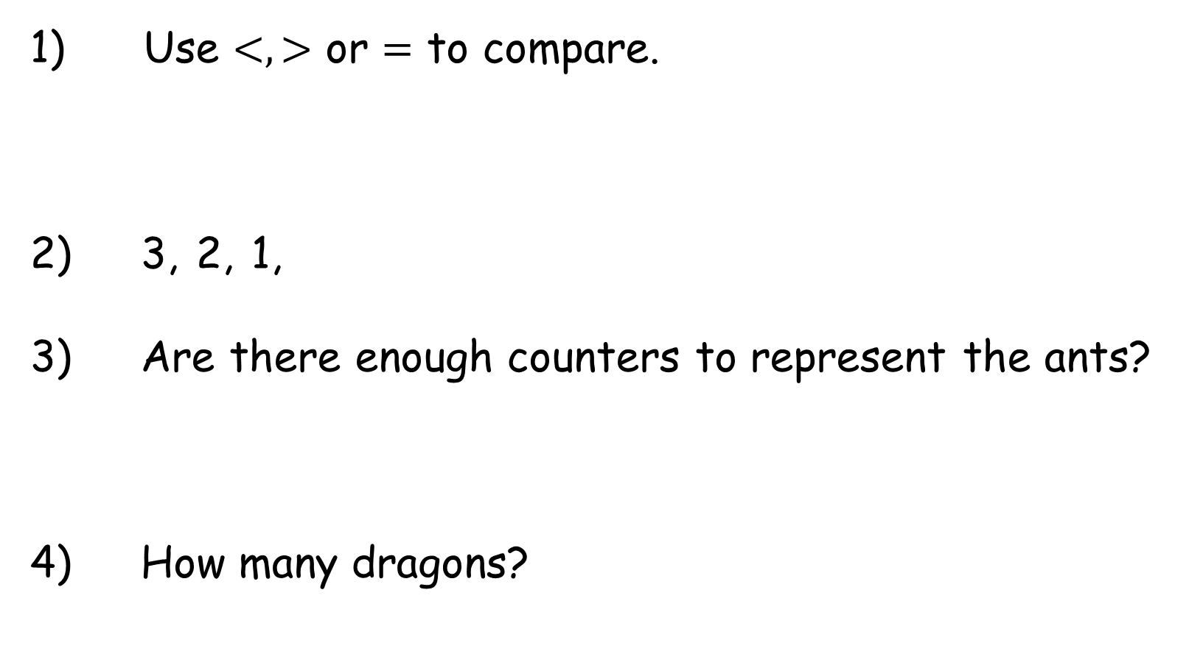
Year 1 | Week 4 | Day 5
Use $<, >$ or $=$ to compare.
2) 3, 2, 1,
3) Are there enough counters to represent the ants?
4) How many dragons?

Slide 40
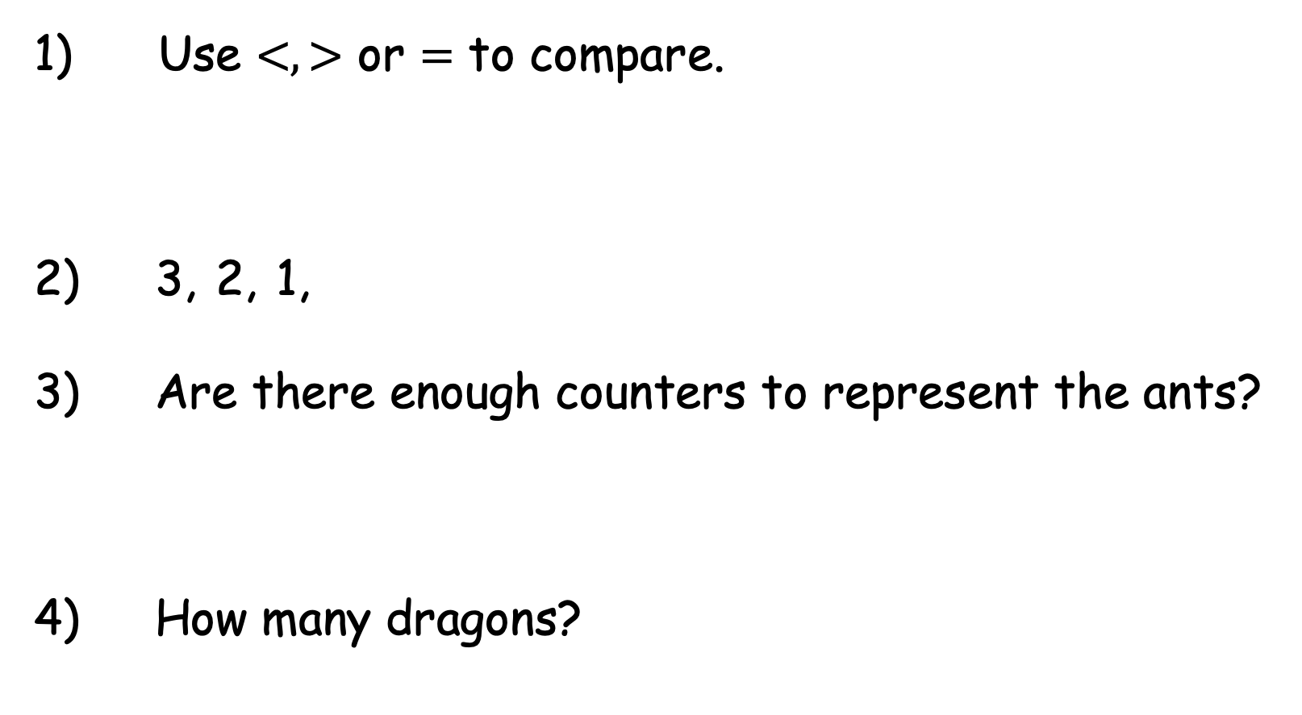

Year 1 | Week 4 | Day 5
Use $<, >$ or $=$ to compare.
2) 3, 2, 1,
3) Are there enough counters to represent the ants?
4) How many dragons?
$$>$$
0
No
3

Slide 41
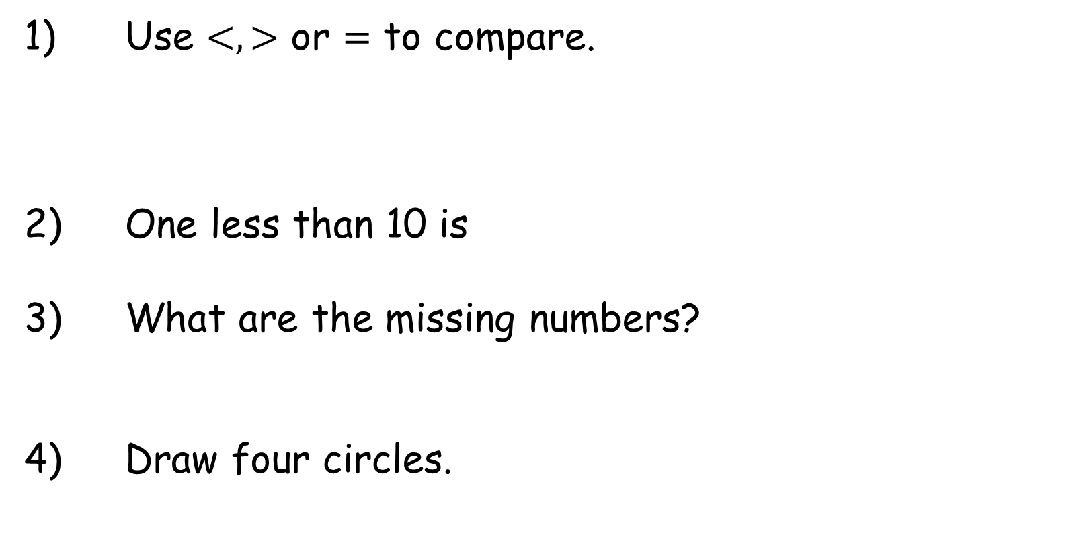
Year 1 | Week 5 | Day 1
1) Use $<, >$ or $=$ to compare.
2) One less than 10 is
3) What are the missing numbers?
4) Draw four circles.
7 9
 | 2 |  | 4 | 5 | 6 | 7 | 8 | 9

Slide 42

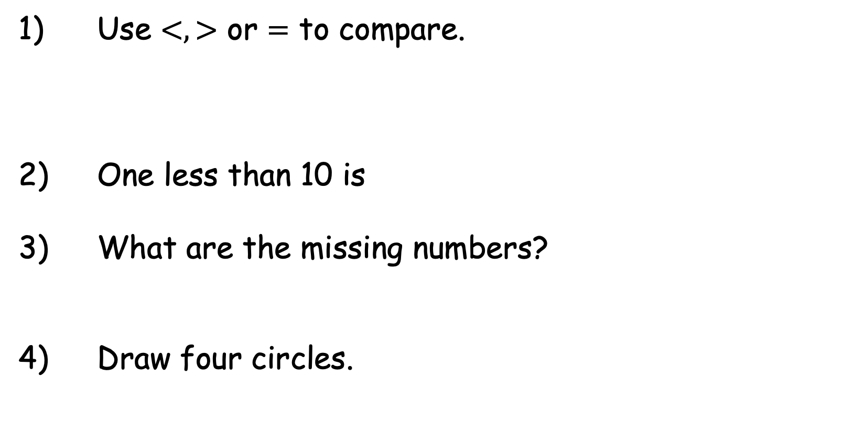
Year 1 | Week 5 | Day 1
1) Use $<, >$ or $=$ to compare.
2) One less than 10 is
3) What are the missing numbers?
4) Draw four circles.
$$<$$
7 9
9
 | 2 |  | 4 | 5 | 6 | 7 | 8 | 9
1
3
10

Slide 43




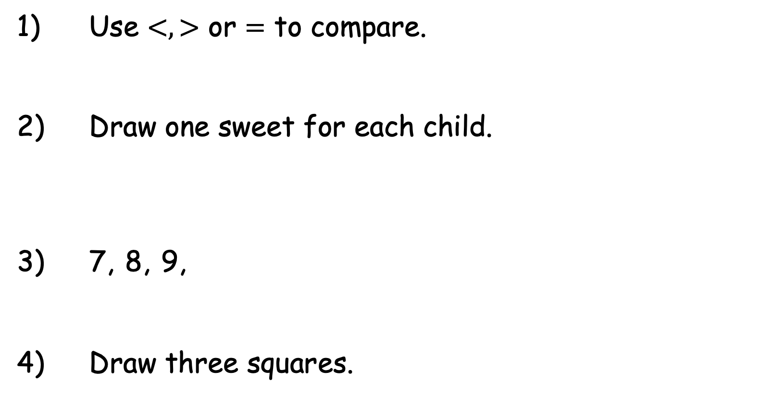
Year 1 | Week 5 | Day 2
1) Use $<, >$ or $=$ to compare.
2) Draw one sweet for each child.
3) 7, 8, 9,
4) Draw three squares.
10 6

Slide 44

Year 1 | Week 5 | Day 2
1) Use $<, >$ or $=$ to compare.
2) Draw one sweet for each child.
3) 7, 8, 9,
4) Draw three squares.
$$>$$
10 6
10

Slide 45



Year 1 | Week 5 | Day 3
1) Put the ladybirds in order by number of spots, starting with the smallest.
2) Which set has fewer dots?
3) One more than 0 is
4) Draw two triangles.

Slide 46
Year 1 | Week 5 | Day 3
1) Put the ladybirds in order by number of spots, starting with the smallest.
2) Which set has fewer dots?
3) One more than 0 is
4) Draw two triangles.
1

Slide 47
Year 1 | Week 5 | Day 4
1) Put the numbers in order from smallest to greatest.
2) 1 is _______ than 10
3) What comes next?
4) Draw five squares.
8 3 5

Slide 48
Year 1 | Week 5 | Day 4
1) Put the numbers in order from smallest to greatest.
2) 1 is _______ than 10
3) What comes next?
4) Draw five squares.
8 3 5
3 5 8
less

Slide 49


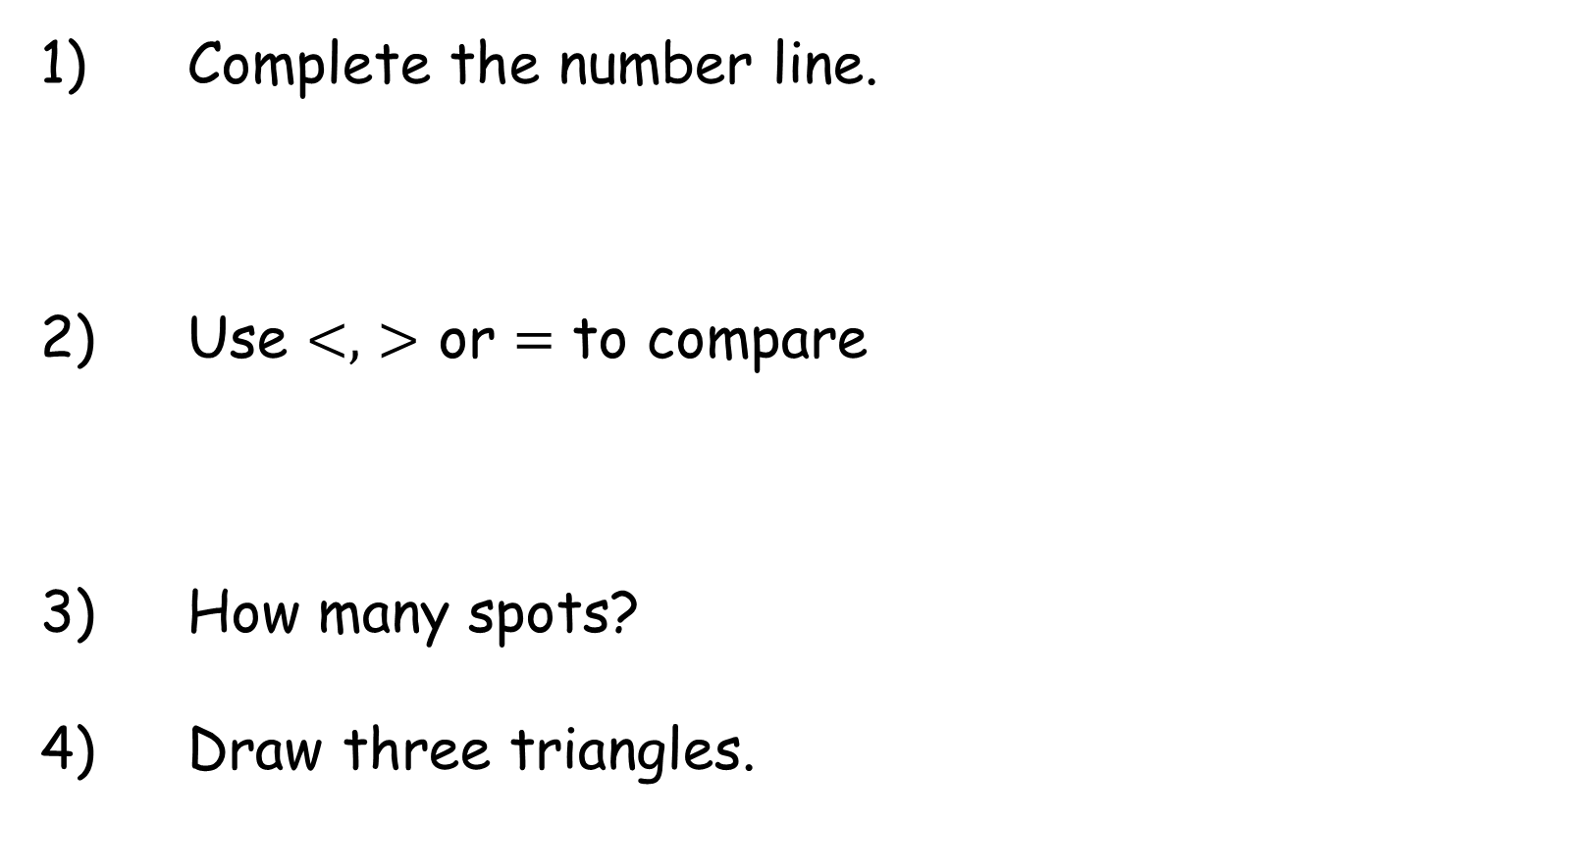
Year 1 | Week 5 | Day 5
Complete the number line.
2) Use $<,$ $>$ or $=$ to compare
3) How many spots?
4) Draw three triangles.
0
2
3
4
6
7
9
10

Slide 50

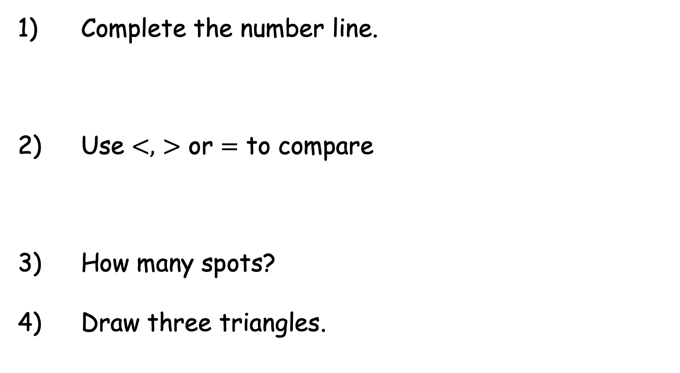
Year 1 | Week 5 | Day 5
Complete the number line.
2) Use $<,$ $>$ or $=$ to compare
3) How many spots?
4) Draw three triangles.
0
1
2
3
4
5
6
7
8
9
10
$$>$$
10

