Slide 1





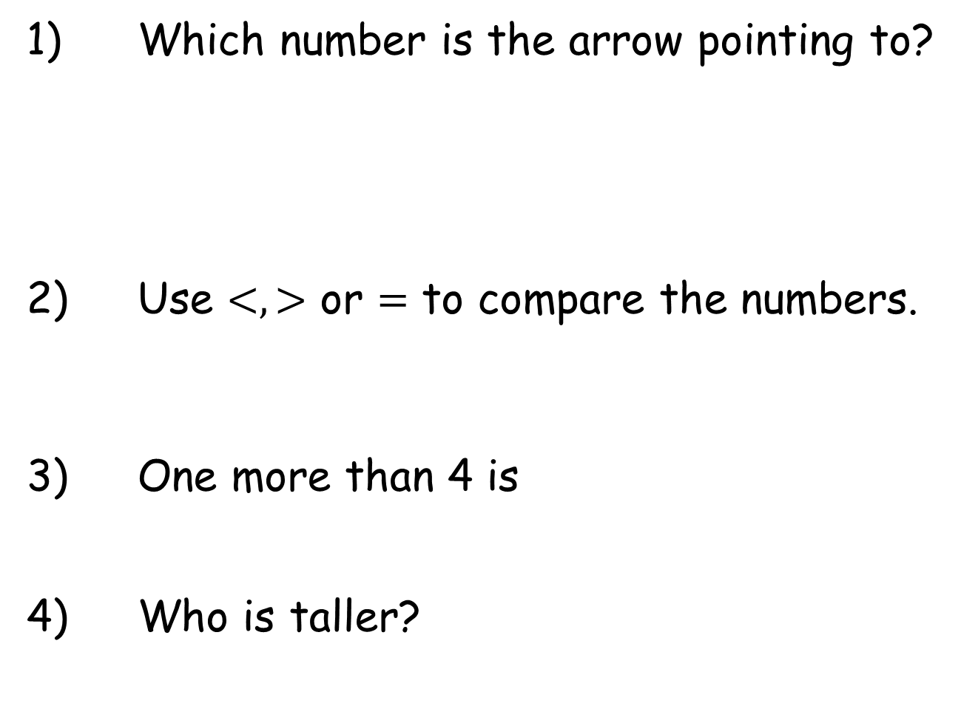
Year 1 | Week 6 | Day 1
1) Which number is the arrow pointing to?
2) Use $<,>$ or $=$ to compare the numbers.
3) One more than 4 is
4) Who is taller?
0
10
$$<$$
Tommy
Rosie

Slide 2

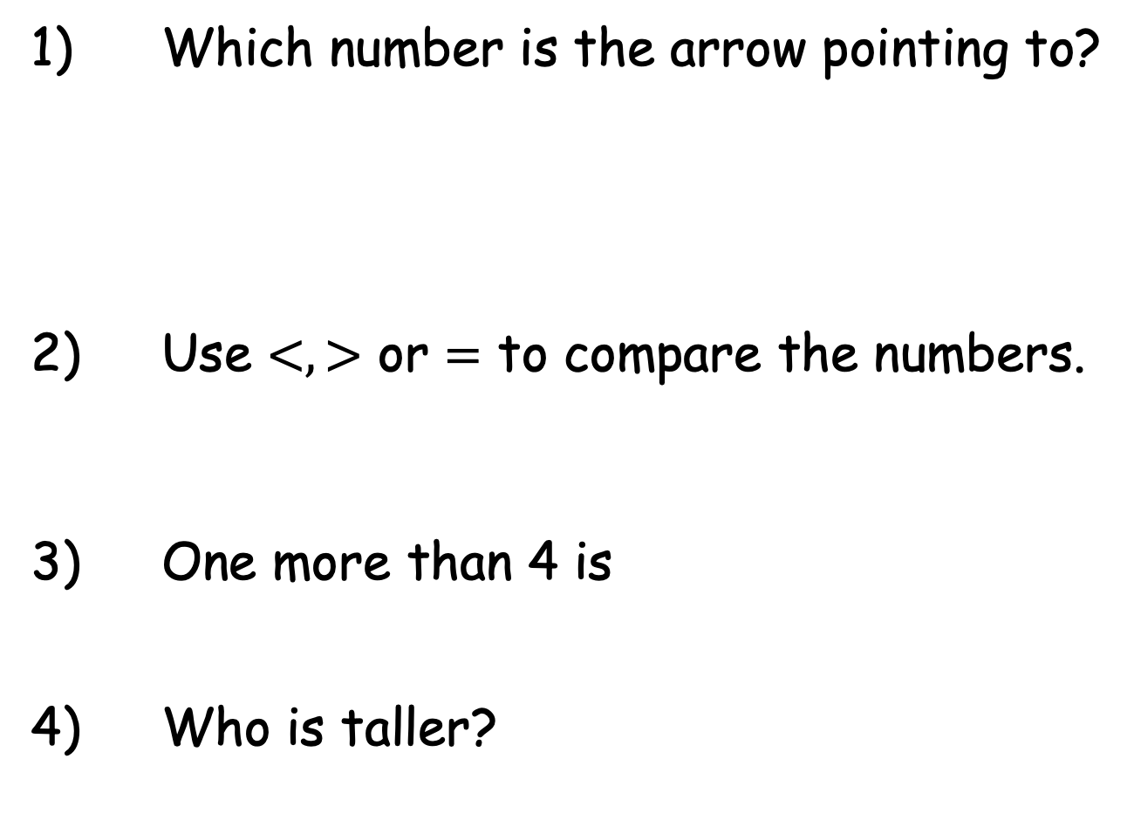
Year 1 | Week 6 | Day 1
1) Which number is the arrow pointing to?
2) Use $<,>$ or $=$ to compare the numbers.
3) One more than 4 is
4) Who is taller?
3
0
10
$$<$$
1 5
5
Rosie
Tommy
Rosie

Slide 3
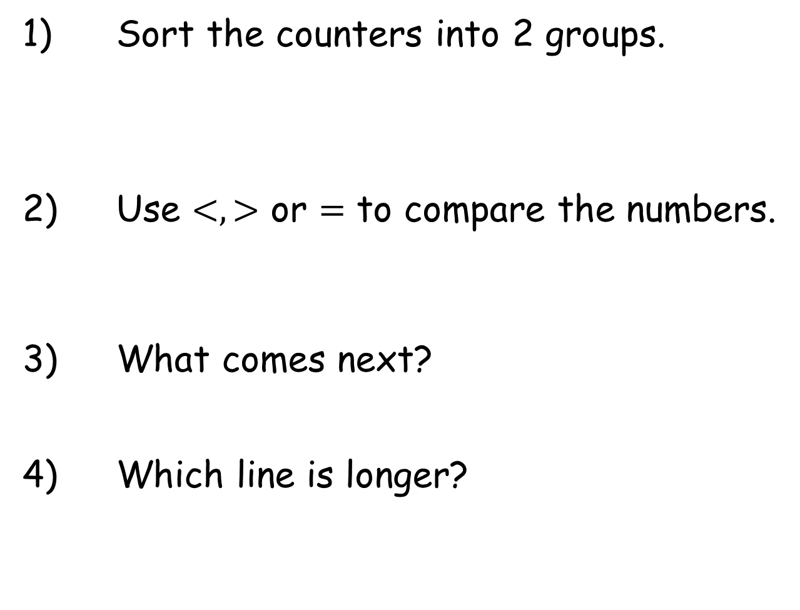
Year 1 | Week 6 | Day 2
1) Sort the counters into 2 groups.
2) Use $<,>$ or $=$ to compare the numbers.
3) What comes next?
4) Which line is longer?
9 8
A
B

Slide 4

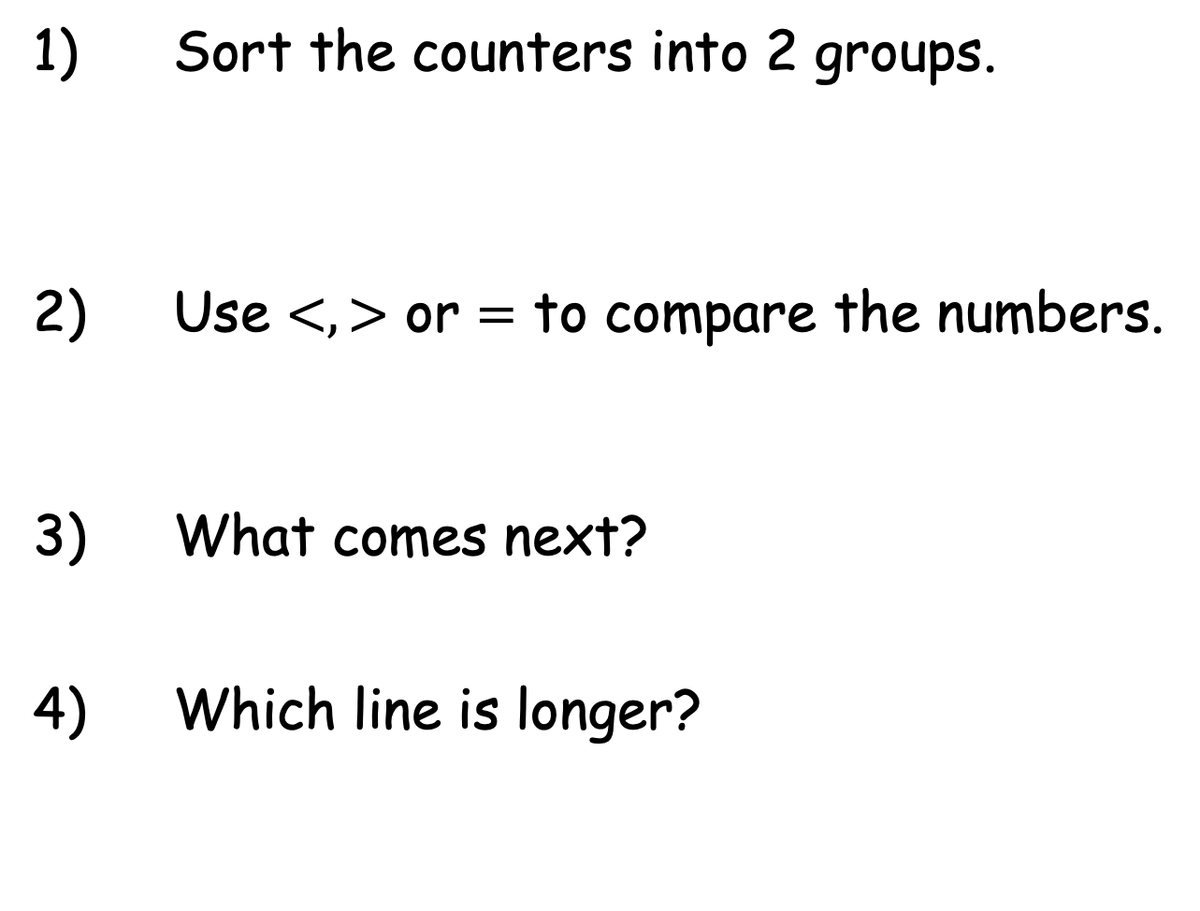
Year 1 | Week 6 | Day 2
1) Sort the counters into 2 groups.
2) Use $<,>$ or $=$ to compare the numbers.
3) What comes next?
4) Which line is longer?
$$>$$
9 8
A
A
B

Slide 5


Year 1 | Week 6 | Day 3
1) Draw the whole.
2) Put the groups in order starting with the smallest.
3) 7, 6, 5,
4) Who is shorter?
Tommy
Rosie

Slide 6
Year 1 | Week 6 | Day 3
1) Draw the whole.
2) Put the groups in order starting with the smallest.
3) 7, 6, 5,
4) Who is shorter?
4
Tommy
Tommy
Rosie

Slide 7


Year 1 | Week 6 | Day 4
1) Draw the whole.
2) Write the numbers in order,
starting with the smallest.
3) One less than 10 is
4) Which line is shorter?
8, 6, 7
A
B

Slide 8
Year 1 | Week 6 | Day 4
1) Draw the whole.
2) Write the numbers in order,
starting with the smallest.
3) One less than 10 is
4) Which line is shorter?
8, 6, 7
6, 7, 8
9
B
A
B

Slide 9


Year 1 | Week 6 | Day 5
1)
2) Complete the number line.
Is there a key for
each house?
4) Draw 5 squares.
5
4
1
2
3
5
6
7
8
10

Slide 10
Year 1 | Week 6 | Day 5
1)
2) Complete the number line.
Is there a key for
each house?
4) Draw 5 squares.
9
5
4
0
1
2
3
4
5
6
7
8
9
10
No

Slide 11

Year 1 | Week 7 | Day 1
1)
2) Sort the apples into 2 groups.
3) 4 is ______ than 7
4) Draw 4 circles.
2
5

Slide 12

Year 1 | Week 7 | Day 1
1)
2) Sort the apples into 2 groups.
3) 4 is ______ than 7
4) Draw 4 circles.
7
2
5
less

Slide 13





Year 1 | Week 7 | Day 2
1) Write an addition for the owls.
2) Draw the whole.
3) 8 is ______ than 4
4) Which is heavier?

Slide 14
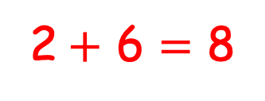
Year 1 | Week 7 | Day 2
1) Write an addition for the owls.
2) Draw the whole.
3) 8 is ______ than 4
4) Which is heavier?
2$+$ 6 $=$ 8
greater
The car

Slide 15





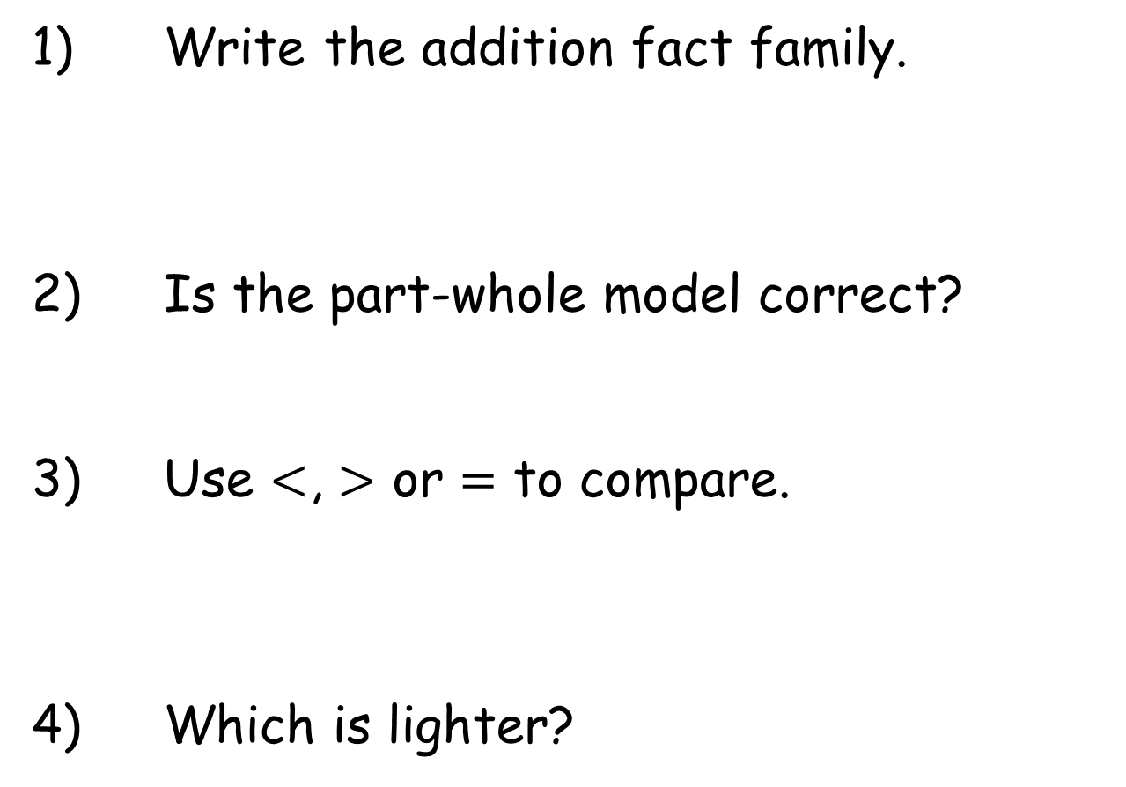
Year 1 | Week 7 | Day 3
1
1) Write the addition fact family.
2) Is the part-whole model correct?
3) Use $<$, $>$ or $=$ to compare.
4) Which is lighter?
5
4

Slide 16
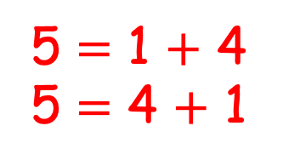
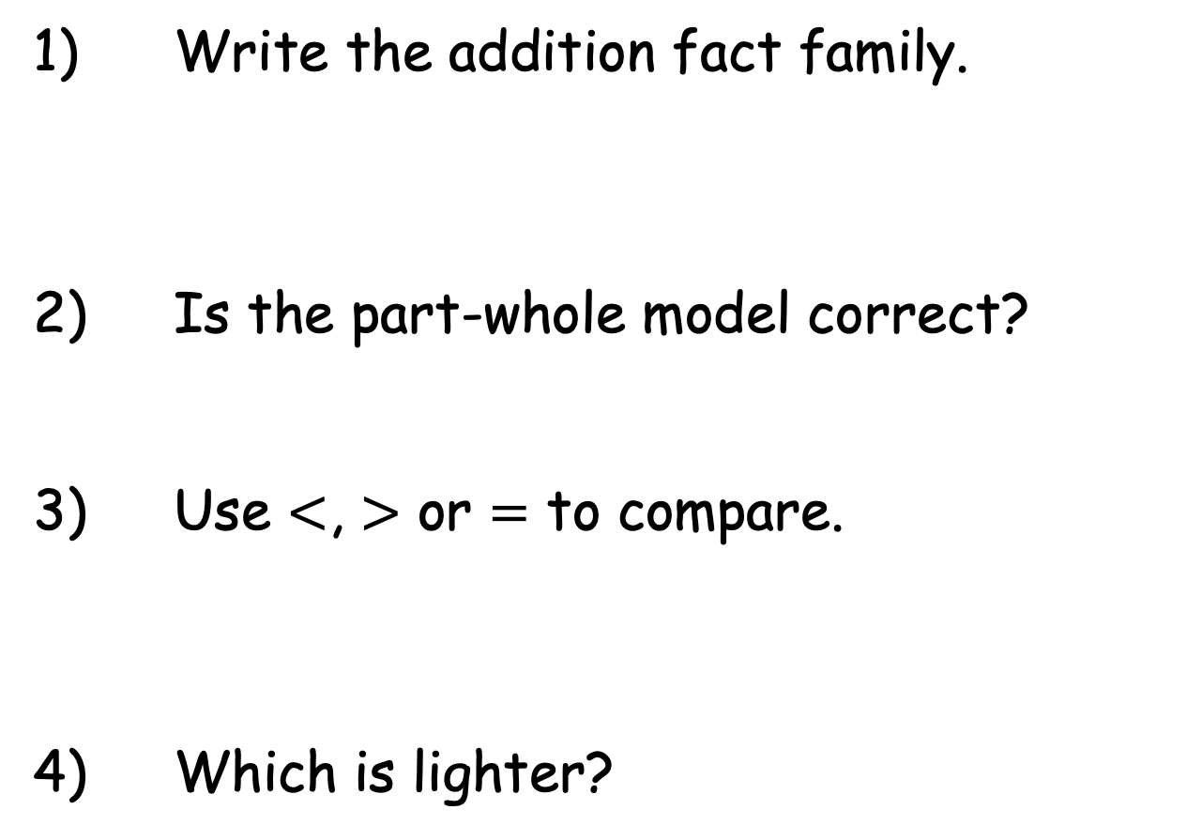
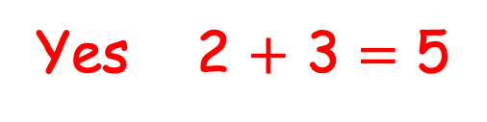
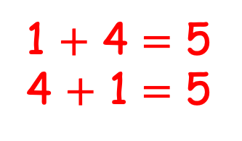

Year 1 | Week 7 | Day 3
1
1) Write the addition fact family.
2) Is the part-whole model correct?
3) Use $<$, $>$ or $=$ to compare.
4) Which is lighter?
1 $+$ 4 $=$ 5
4 $+$ 1 $=$ 5
5 $=$ 1 $+$ 4
5 $=$ 4 $+$ 1
5
4
Yes 2 $+$ 3 $=$ 5
$$>$$
The pencil

Slide 17

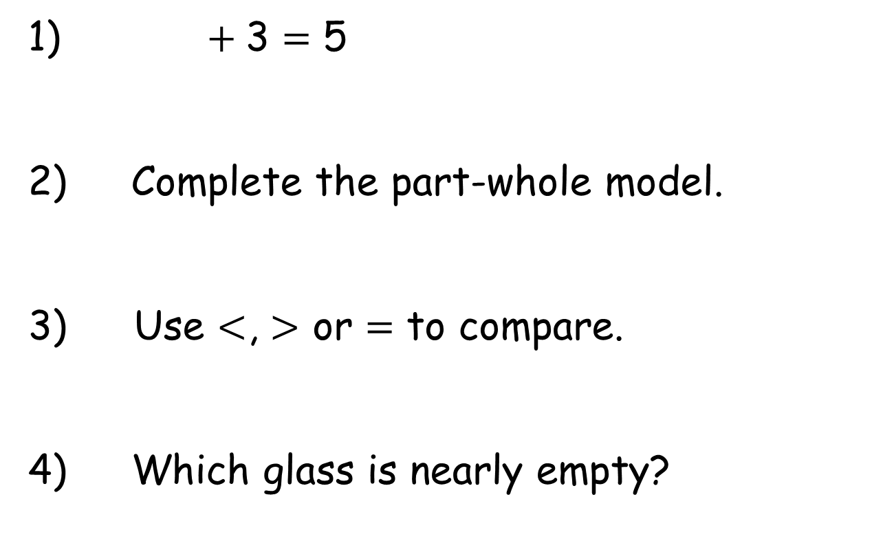
Year 1 | Week 7 | Day 4
1) $+$3 $=$ 5
2) Complete the part-whole model.
Use $<$, $>$ or $=$ to compare.
4) Which glass is nearly empty?
1
6
1 0
A
B

Slide 18
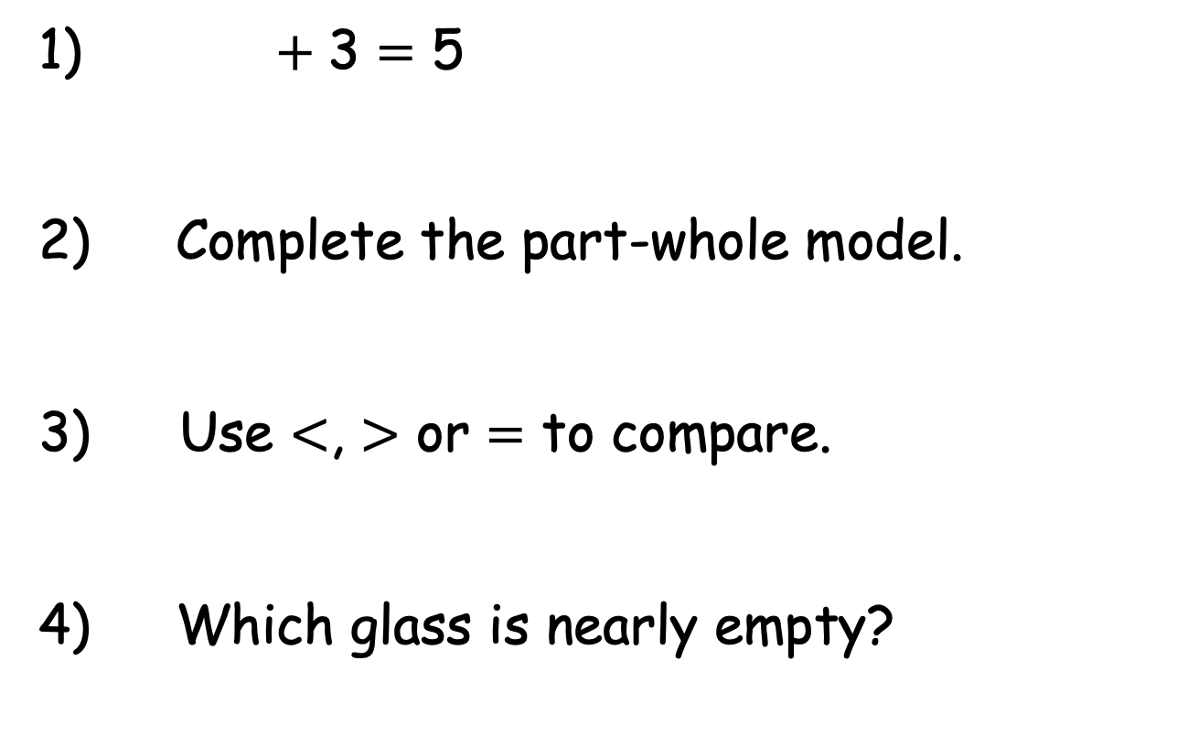

Year 1 | Week 7 | Day 4
1) $+$3 $=$ 5
2) Complete the part-whole model.
Use $<$, $>$ or $=$ to compare.
4) Which glass is nearly empty?
2
1
7
6
1 0
$$>$$
A
B

Slide 19
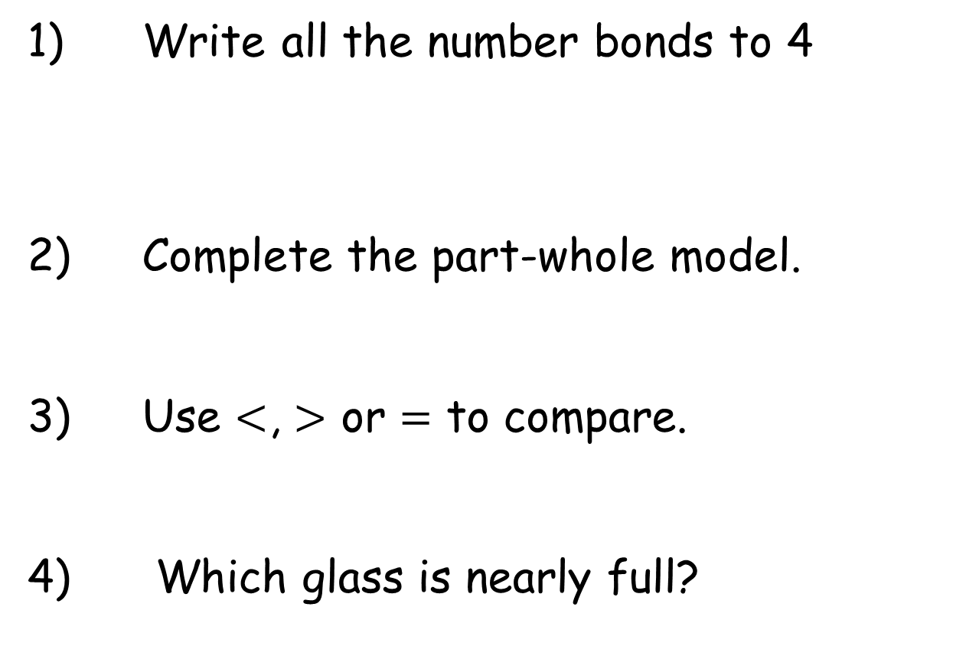
Year 1 | Week 7 | Day 5
1) Write all the number bonds to 4
2) Complete the part-whole model.
3) Use $<$, $>$ or $=$ to compare.
4) Which glass is nearly full?
8
2
1 10
A
B

Slide 20

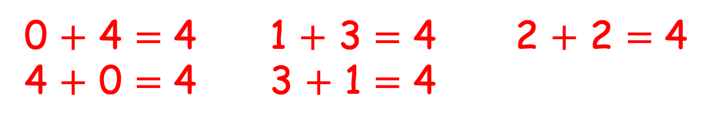
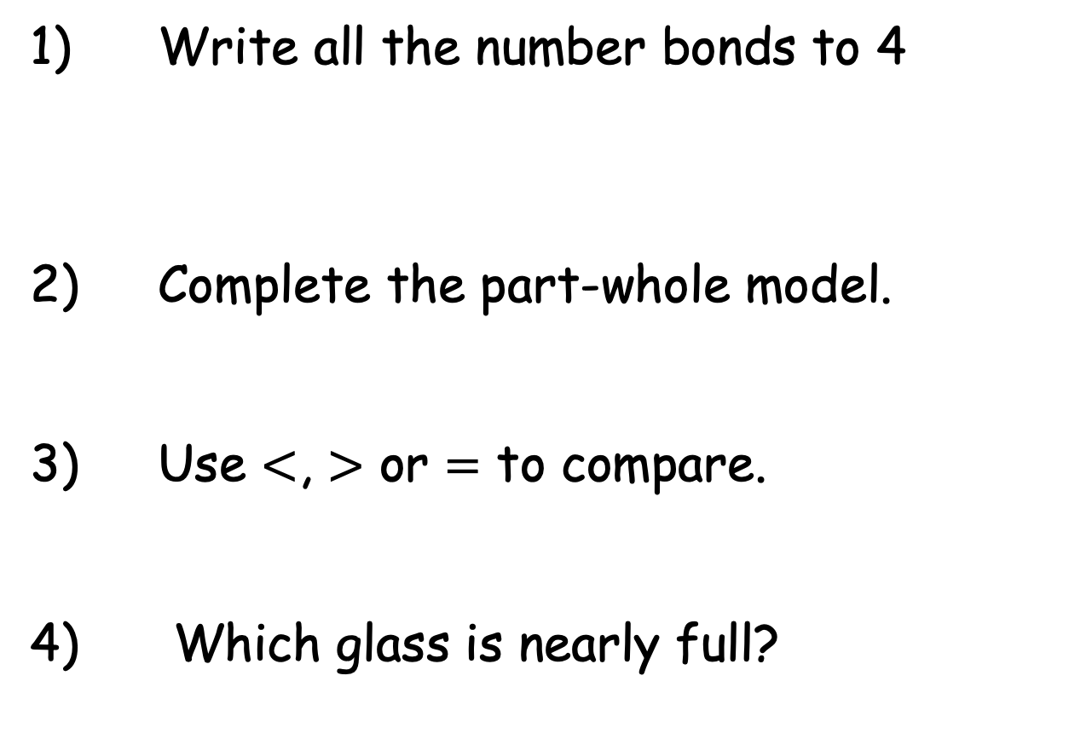
Year 1 | Week 7 | Day 5
1) Write all the number bonds to 4
2) Complete the part-whole model.
3) Use $<$, $>$ or $=$ to compare.
4) Which glass is nearly full?
0 $+$ 4 $=$ 4 1 $+$ 3 $=$ 4 2 $+$ 2 $=$ 4
4 $+$ 0 $=$ 4 3 $+$ 1 $=$ 4
8
10
2
$$<$$
1 10
A
B

Slide 21




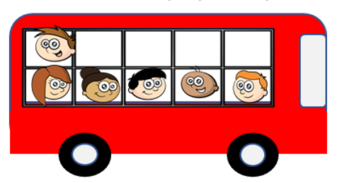





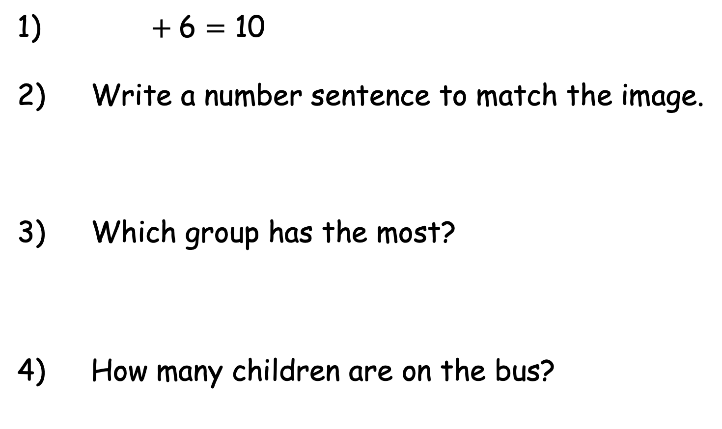
Year 1 | Week 8 | Day 1
1) $+$6 $=$ 10
2) Write a number sentence to match the image.
3) Which group has the most?
4) How many children are on the bus?

Slide 22
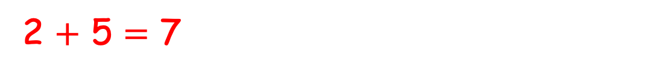
Year 1 | Week 8 | Day 1
4
1) $+$6 $=$ 10
2) Write a number sentence to match the image.
3) Which group has the most?
4) How many children are on the bus?
2 $+$ 5 $=$ 7
5

Slide 23



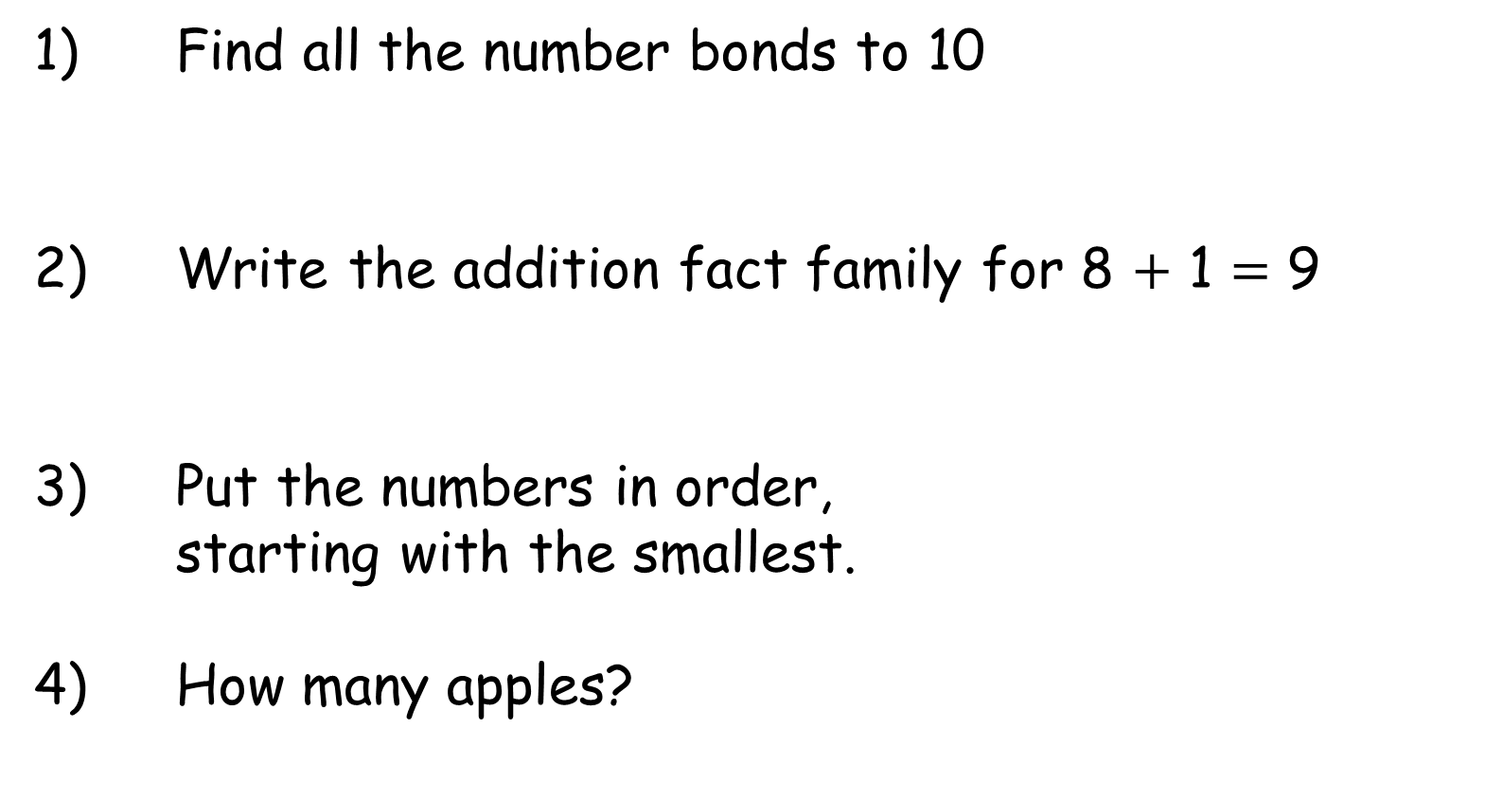
Year 1 | Week 8 | Day 2
1) Find all the number bonds to 10
2) Write the addition fact family for 8 $+$ 1 $=$ 9
3) Put the numbers in order,
starting with the smallest.
4) How many apples?
10 , 7 , 8

Slide 24
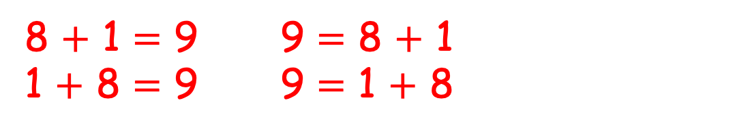
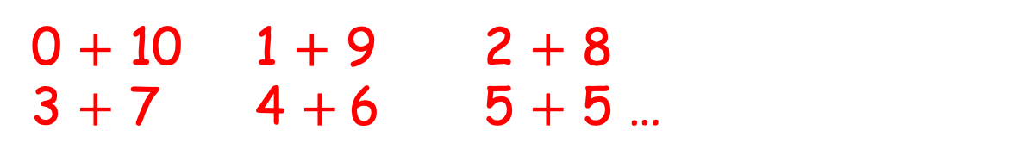
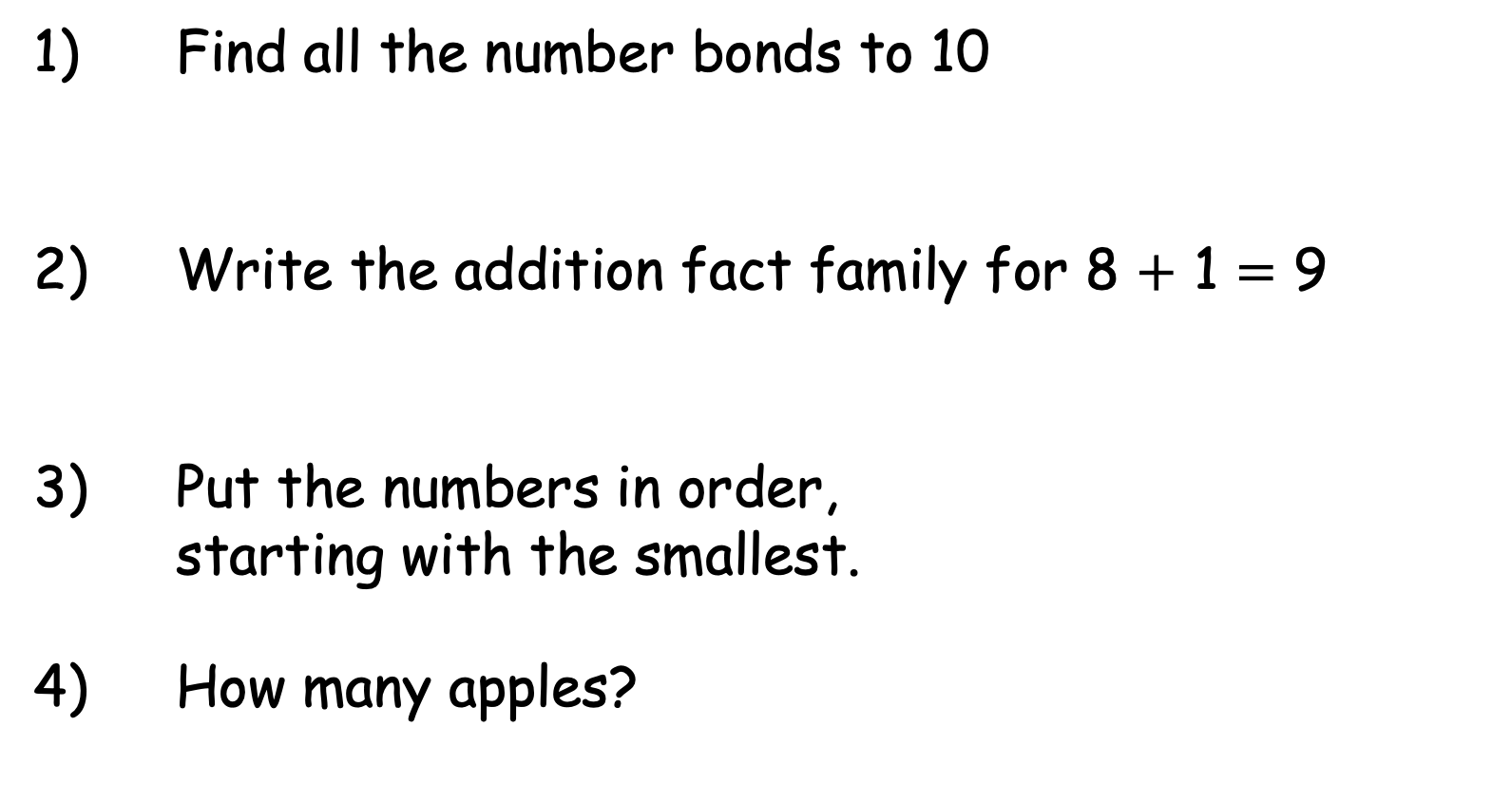
Year 1 | Week 8 | Day 2
1) Find all the number bonds to 10
2) Write the addition fact family for 8 $+$ 1 $=$ 9
3) Put the numbers in order,
starting with the smallest.
4) How many apples?
0 $+$ 10 1 $+$ 9 2 $+$ 8
3 $+$ 7 4 $+$6 5 $+$ 5 …
8 $+$ 1 $=$ 9 9 $=$ 8 $+$ 1
1 $+$ 8 $=$ 9 9 $=$ 1 $+$ 8
10 , 7 , 8
7 , 8 , 10
7

Slide 25



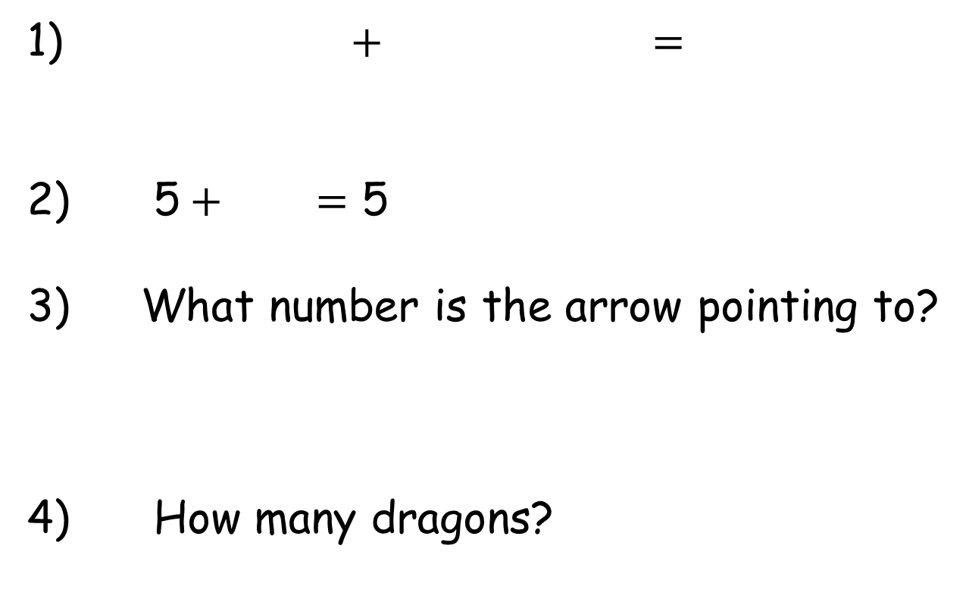
Year 1 | Week 8 | Day 3
1) $+$ $=$
2) 5$+$ $=$ 5
3) What number is the arrow pointing to?
4) How many dragons?
0
10

Slide 26
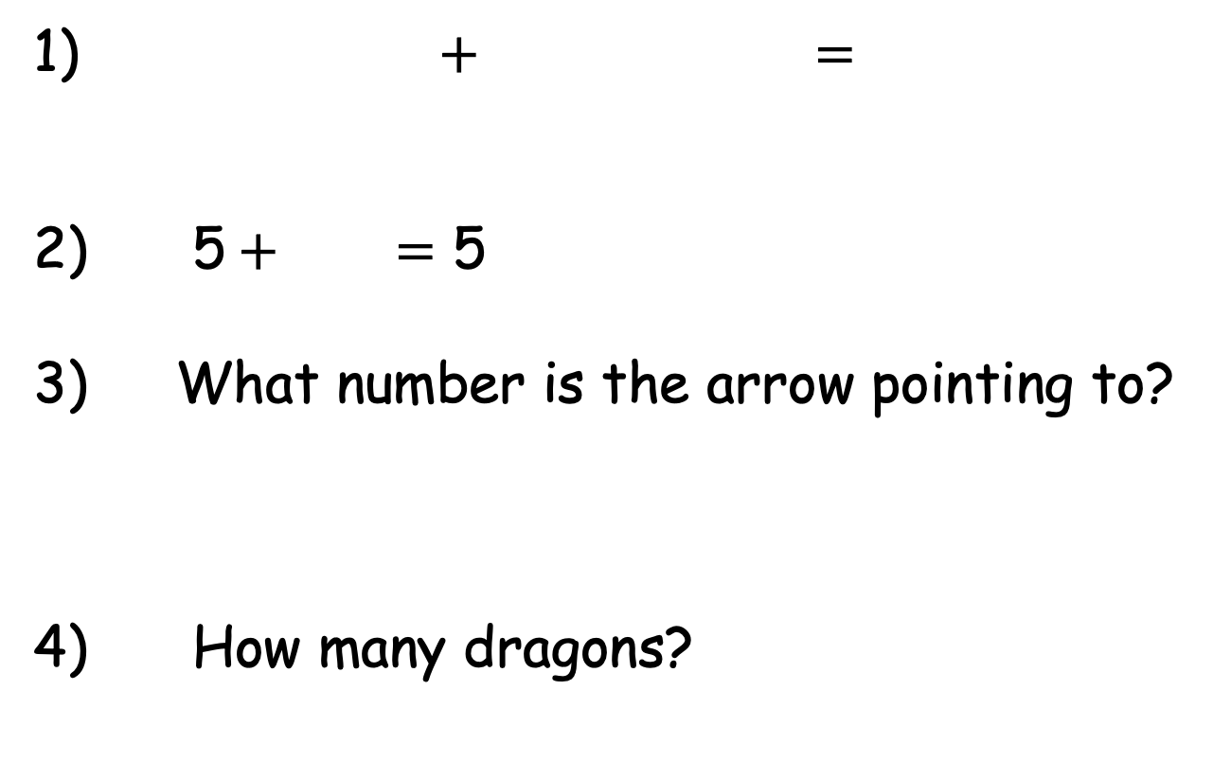
Year 1 | Week 8 | Day 3
1) $+$ $=$
2) 5$+$ $=$ 5
3) What number is the arrow pointing to?
4) How many dragons?
8
0
8
0
10
8

Slide 27

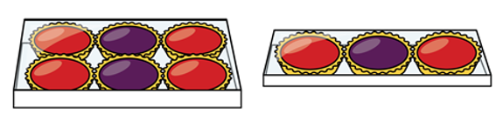
Year 1 | Week 8 | Day 4
1) How many tarts altogether?
2) Find all the number bonds to 6
3) Put the shapes into 2 groups.
4) How many dragons?

Slide 28
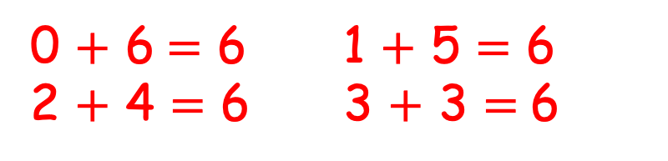
Year 1 | Week 8 | Day 4
1) How many tarts altogether?
2) Find all the number bonds to 6
3) Put the shapes into 2 groups.
4) How many dragons?
9
0 $+$ 6$=$ 6 1 $+$ 5 $=$ 6
2 $+$ 4 $=$ 6 3 $+$ 3 $=$6
5

Slide 29

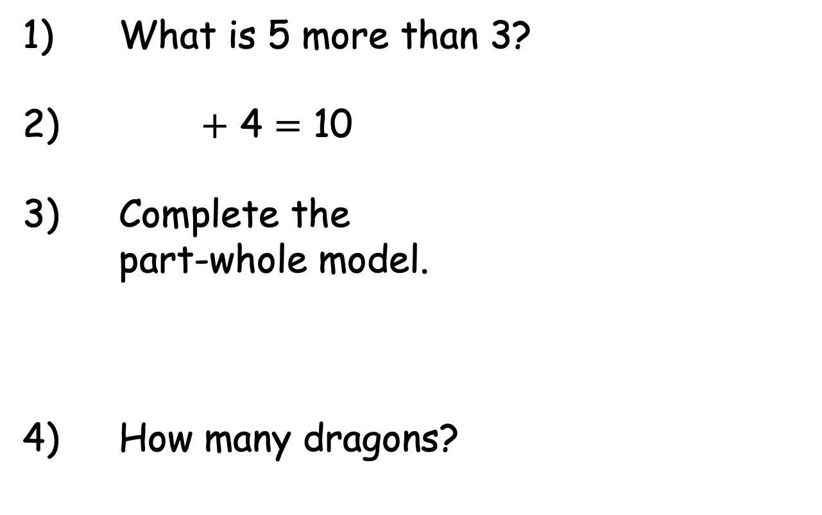
Year 1 | Week 8 | Day 5
1) What is 5 more than 3?
2) $+$ 4 $=$ 10
3) Complete the
part-whole model.
4) How many dragons?

Slide 30
Year 1 | Week 8 | Day 5
1) What is 5 more than 3?
2) $+$ 4 $=$ 10
3) Complete the
part-whole model.
4) How many dragons?
8
6
2

Slide 31
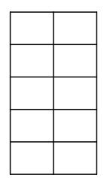


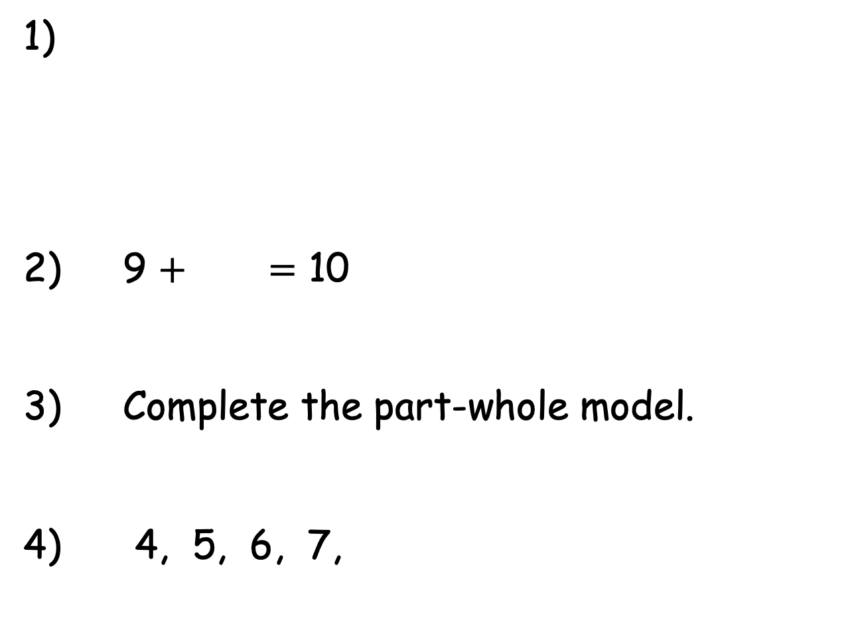
Year 1 | Week 9 | Day 1
5
1)
2) 9 $+$ $=$ 10
3) Complete the part-whole model.
4) 4, 5, 6, 7,
8

Slide 32
Year 1 | Week 9 | Day 1
5
1)
2) 9 $+$ $=$ 10
3) Complete the part-whole model.
4) 4, 5, 6, 7,
8
3
1
8

Slide 33
Year 1 | Week 9 | Day 2
1)
2) Systematically find all the number bonds to 10
3) Complete the part-whole model.
4) 5, 4, 3, 2,
5
1
4
4

Slide 34
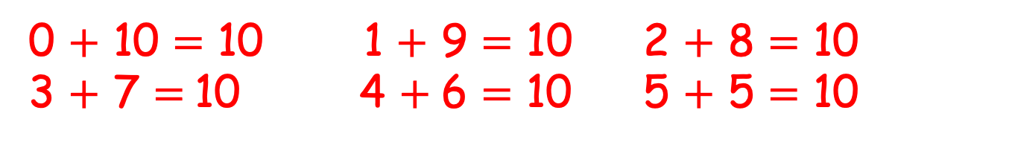
Year 1 | Week 9 | Day 2
4
1)
2) Systematically find all the number bonds to 10
3) Complete the part-whole model.
4) 5, 4, 3, 2,
5
1
0 $+$ 10 $=$ 10 1 $+$ 9 $=$ 10 2 $+$ 8 $=$ 10
3 $+$ 7 $=$10 4 $+$6 $=$ 10 5 $+$ 5 $=$ 10
4
8
4
1

Slide 35



Year 1 | Week 9 | Day 3
1) There are 10 pencils.
Mo takes 2 pencils.
How many are left?
2) How many cubes?
3) Complete the part-whole
model.
4) What number is missing?
5, 4, 2, 1
3
7

Slide 36
Year 1 | Week 9 | Day 3
1) There are 10 pencils.
Mo takes 2 pencils.
How many are left?
2) How many cubes?
3) Complete the part-whole
model.
4) What number is missing?
5, 4, 2, 1
8
9
3
10
7
3

Slide 37


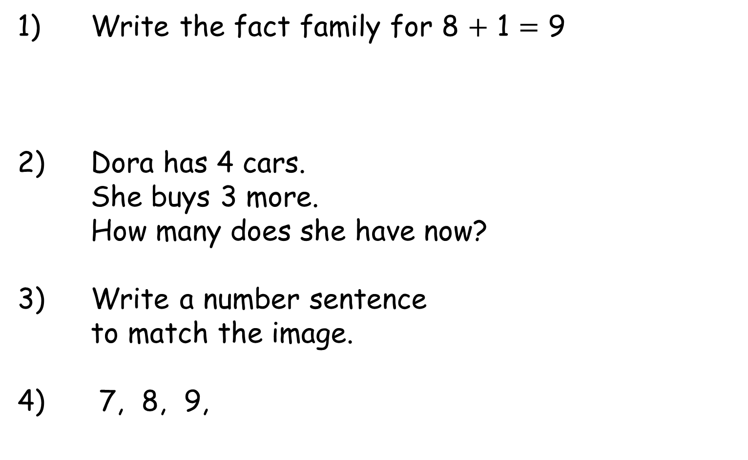
Year 1 | Week 9 | Day 4
1) Write the fact family for 8 $+$ 1 $=$ 9
2) Dora has 4 cars.
She buys 3 more.
How many does she have now?
3) Write a number sentence
to match the image.
4) 7, 8, 9,

Slide 38
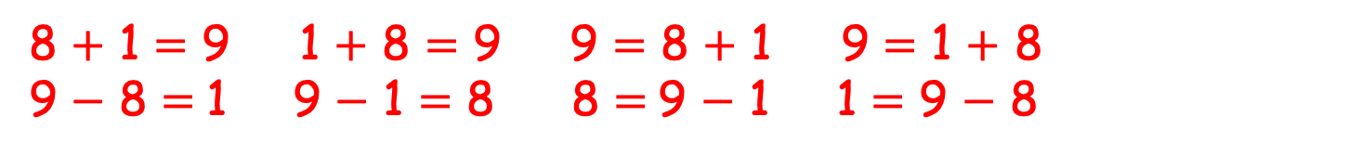
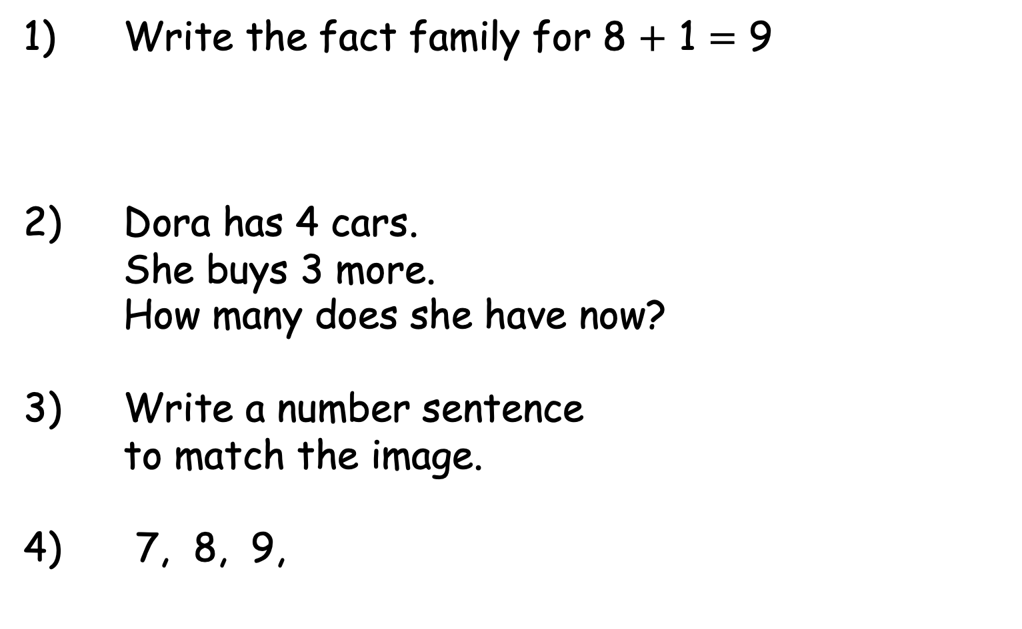
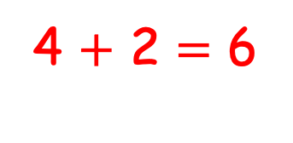
Year 1 | Week 9 | Day 4
1) Write the fact family for 8 $+$ 1 $=$ 9
2) Dora has 4 cars.
She buys 3 more.
How many does she have now?
3) Write a number sentence
to match the image.
4) 7, 8, 9,
8 $+$ 1 $=$ 9 1 $+$ 8 $=$ 9 9 $=$ 8 $+$ 1 9 $=$ 1 $+$ 8
9 $−$ 8 $=$1 9 $−$ 1 $=$ 8 8 $=$9 $−$ 1 1 $=$ 9 $−$ 8
7
4 $+$ 2 $=$ 6
10

Slide 39

Year 1 | Week 9 | Day 5
First
Then
Now
1)
2) How many counters altogether?
3) Write the addition fact family.
4) What number is missing?
5, 6, 7, 9
3
7
4

Slide 40
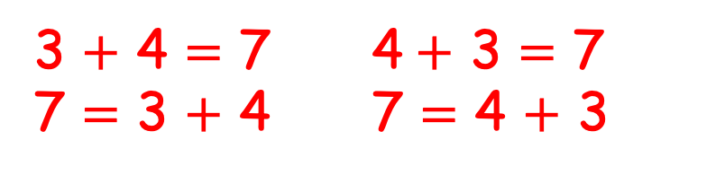
Year 1 | Week 9 | Day 5
First
Then
Now
1)
2) How many counters altogether?
3) Write the addition fact family.
4) What number is missing?
5, 6, 7, 9
6
3
7
3 $+$ 4 $=$ 7 4$+$ 3 $=$ 7
7 $=$ 3 $+$ 4 7 $=$ 4 $+$ 3
4
8

Slide 41

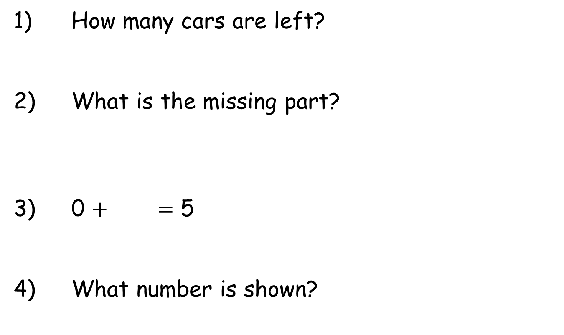
Year 1 | Week 10 | Day 1
1) How many cars are left?
2) What is the missing part?
3) 0 $+$ $=$ 5
4) What number is shown?
7
2

Slide 42
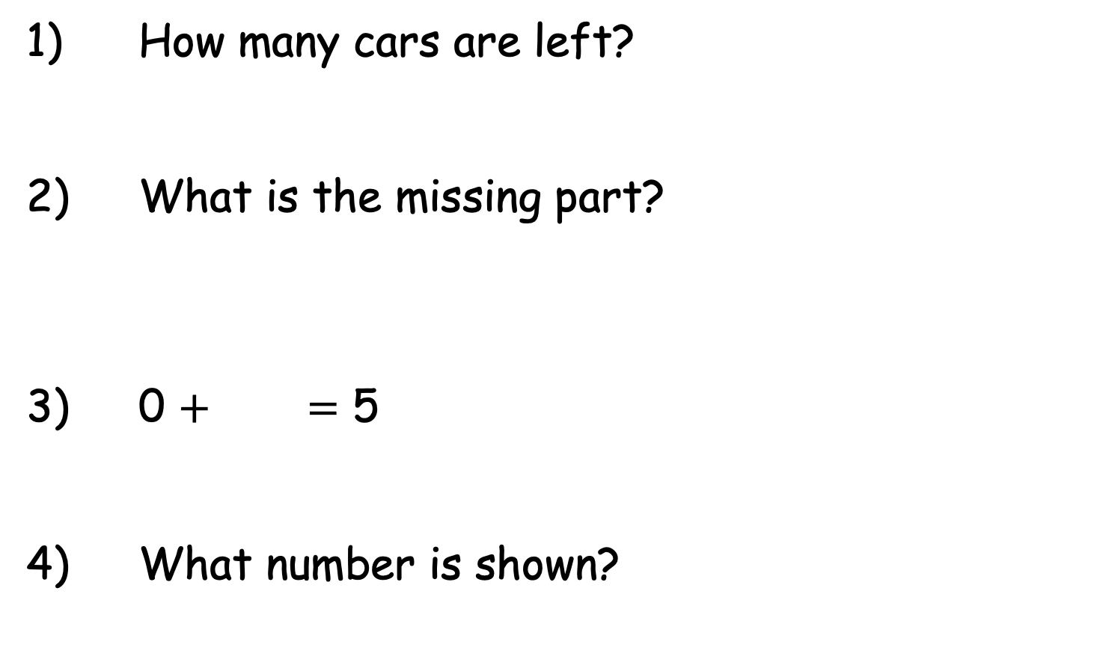
Year 1 | Week 10 | Day 1
4
1) How many cars are left?
2) What is the missing part?
3) 0 $+$ $=$ 5
4) What number is shown?
5
7
2
5
10

Slide 43
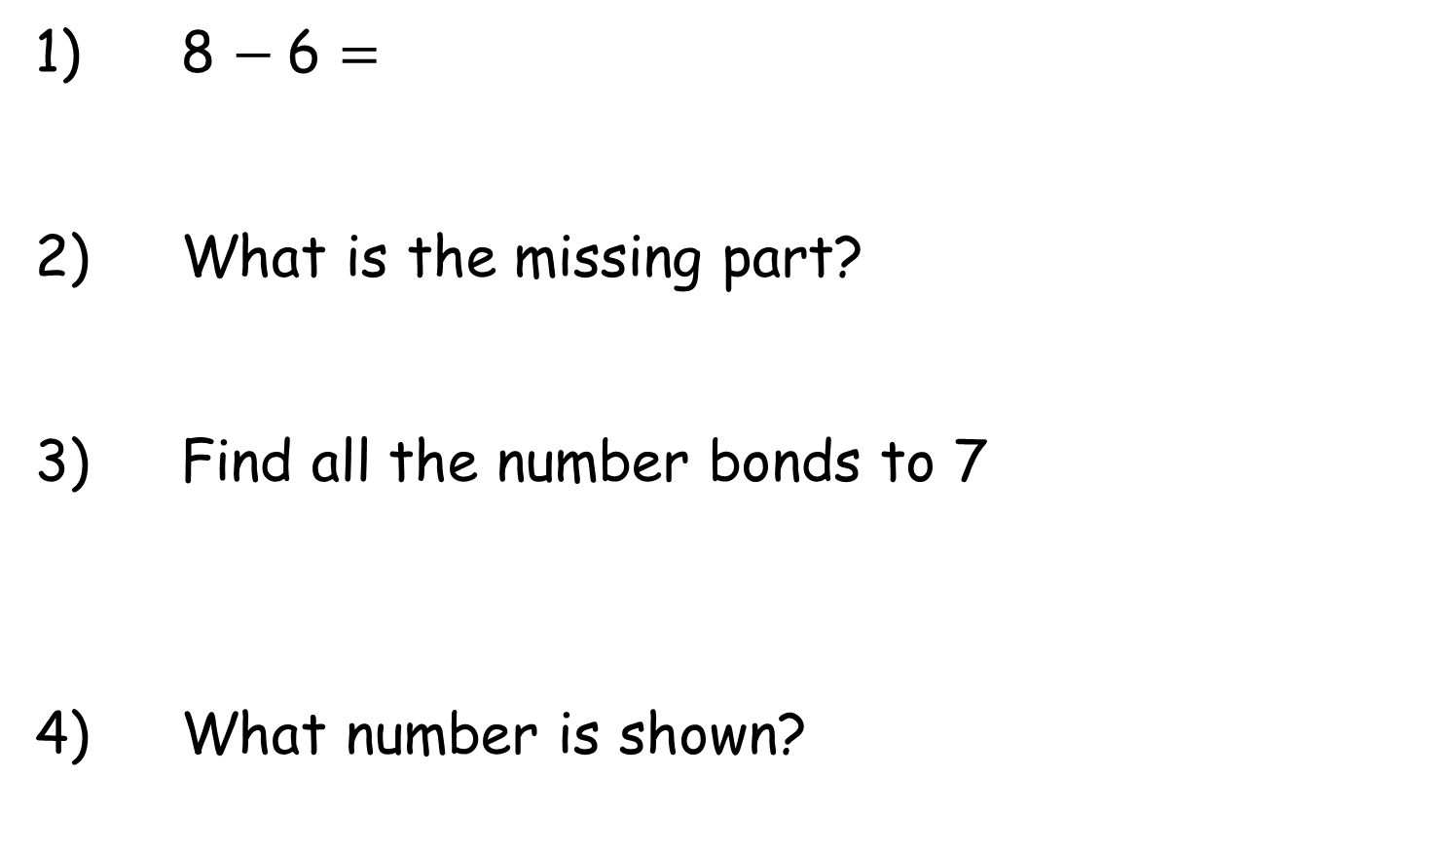
Year 1 | Week 10 | Day 2
1) 8 $−$6 $=$
2) What is the missing part?
3) Find all the number bonds to 7
4) What number is shown?
9
7

Slide 44
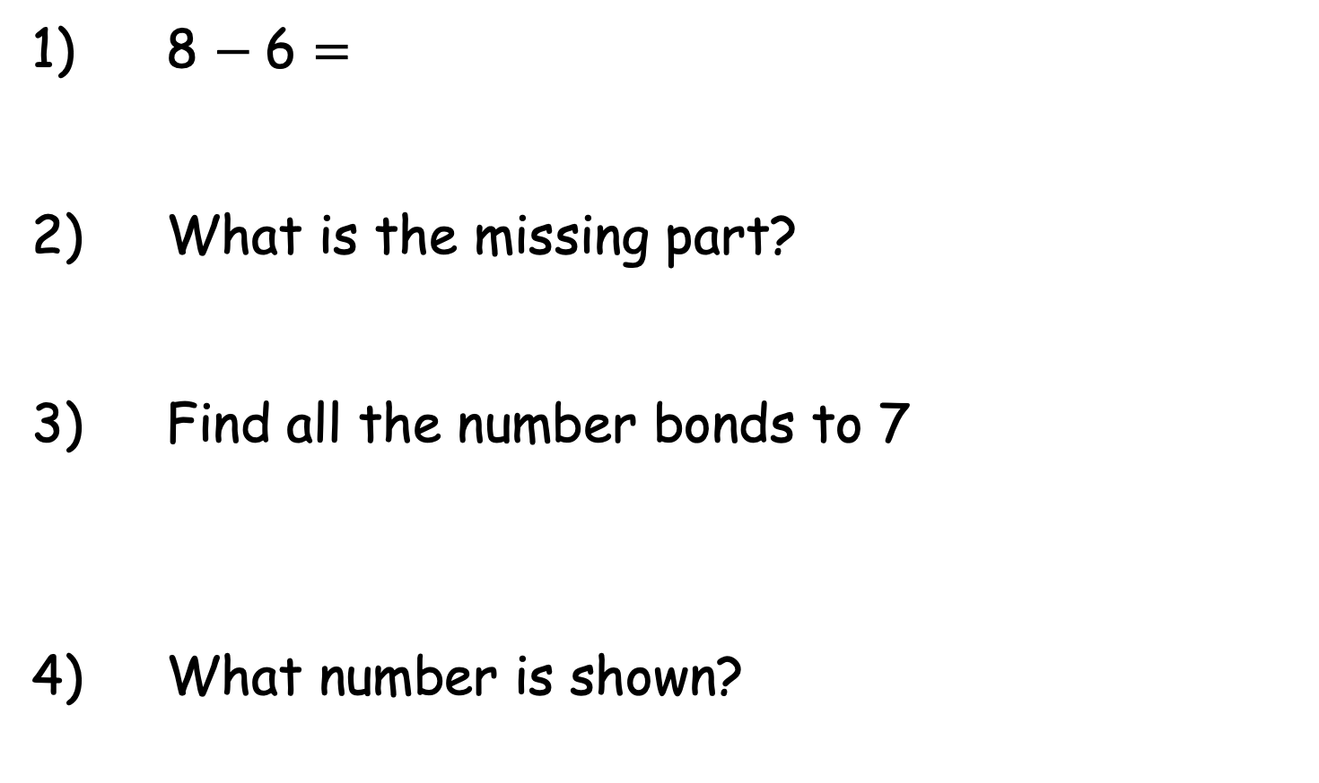
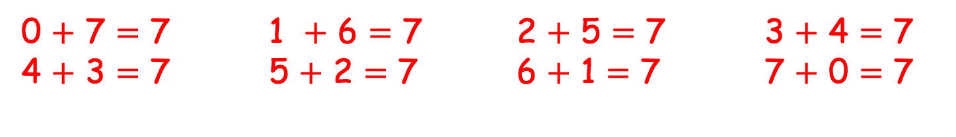
Year 1 | Week 10 | Day 2
1) 8 $−$6 $=$
2) What is the missing part?
3) Find all the number bonds to 7
4) What number is shown?
2
2
9
7
0 $+$ 7 $=$ 7 1 $+$ 6 $=$ 7 2 $+$ 5 $=$ 7 3 $+$ 4 $=$ 7 4 $+$ 3 $=$ 7 5 $+$ 2 $=$ 7 6 $+$ 1 $=$ 7 7 $+$ 0 $=$ 7
4

Slide 45
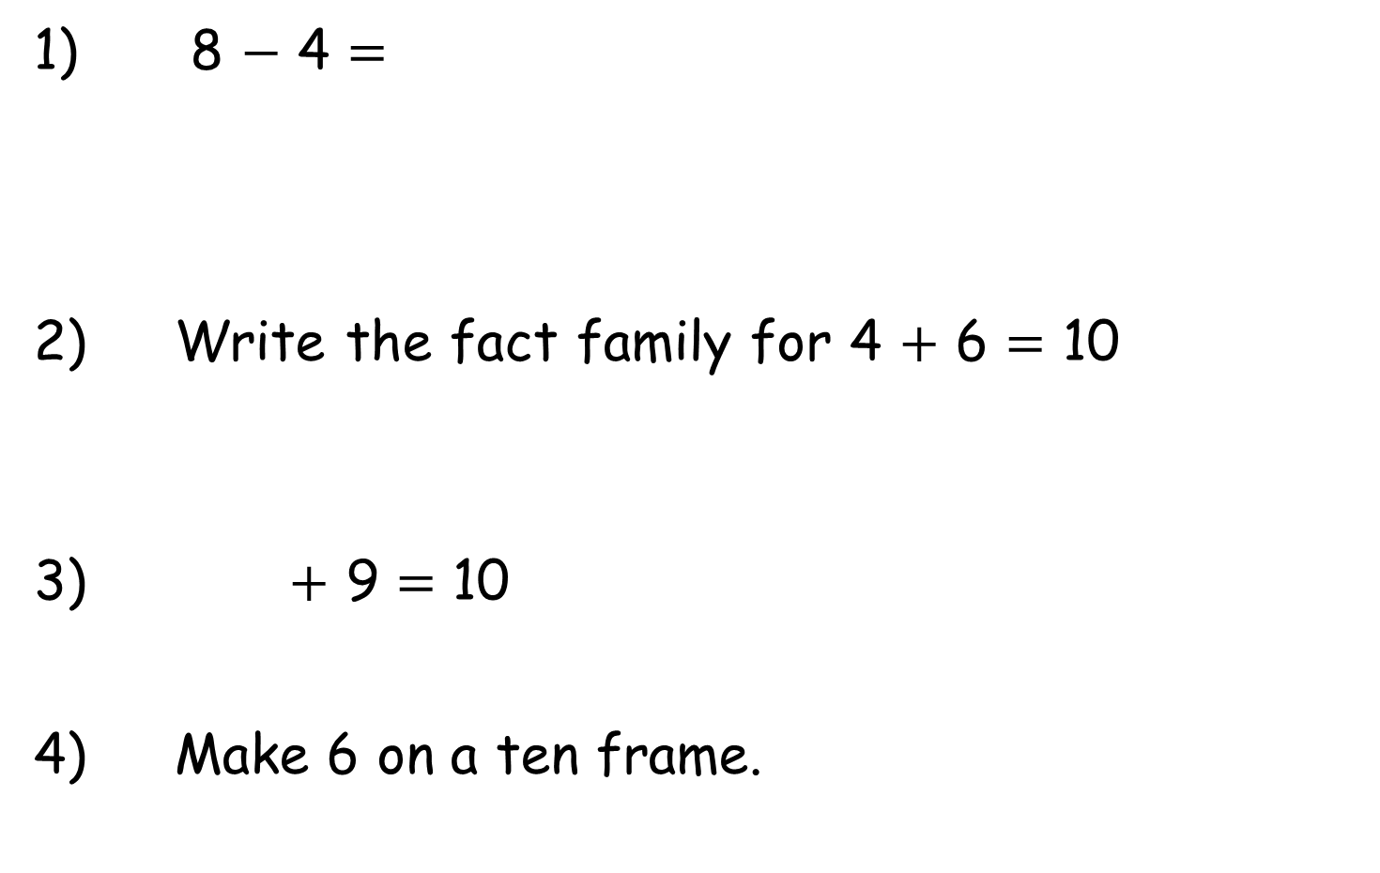
Year 1 | Week 10 | Day 3
1) 8 $−$ 4 $=$
2) Write the fact family for 4 $+$ 6 $=$ 10
3) $+$ 9 $=$ 10
4) Make 6 on a ten frame.
0
8
10

Slide 46
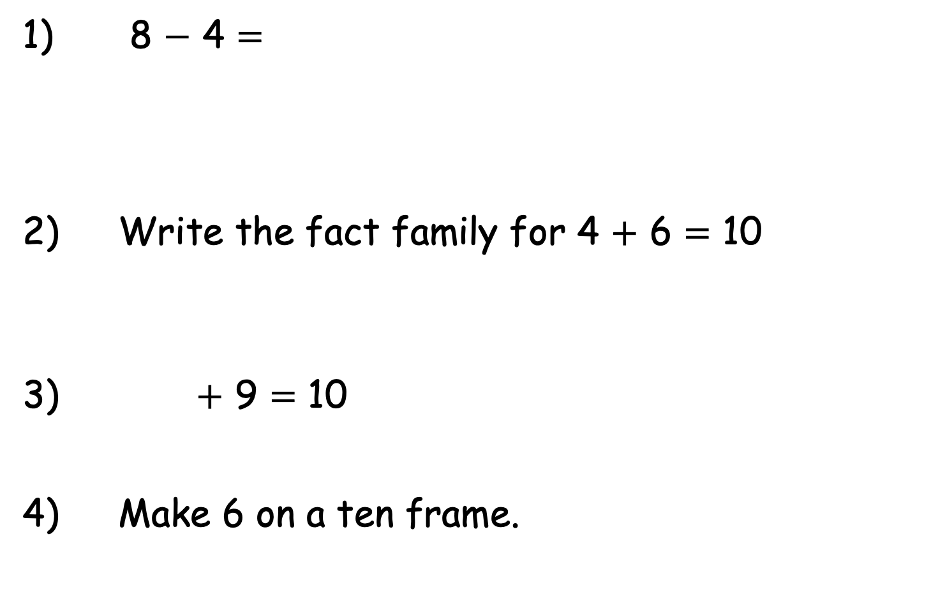
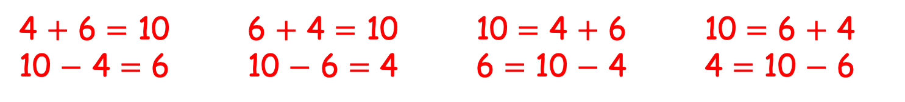
Year 1 | Week 10 | Day 3
1) 8 $−$ 4 $=$
2) Write the fact family for 4 $+$ 6 $=$ 10
3) $+$ 9 $=$ 10
4) Make 6 on a ten frame.
4
0
8
10
4 $+$ 6 $=$ 10 6 $+$ 4 $=$ 10 10 $=$ 4 $+$ 6 10 $=$ 6 $+$ 4
10 $−$ 4 $=$ 6 10 $−$ 6 $=$ 4 6 $=$ 10 $−$ 4 4 $=$ 10 $−$ 6
1
Or 6 counters in any order.

Slide 47
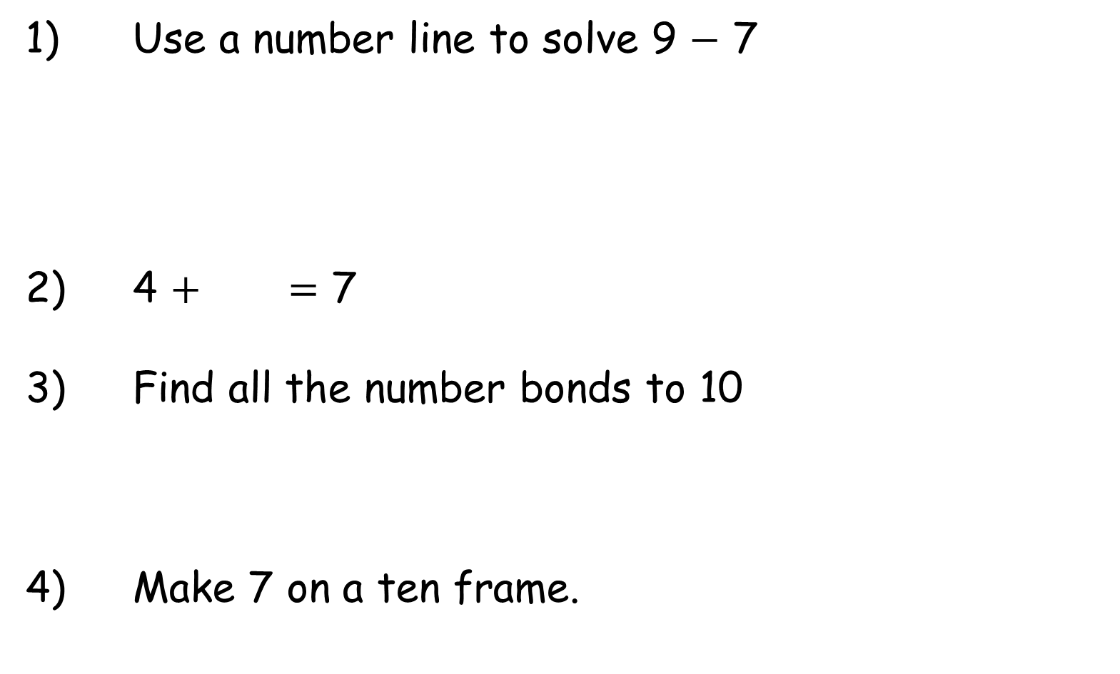
Year 1 | Week 10 | Day 4
1) Use a number line to solve 9 $−$ 7
2) 4 $+$ $=$ 7
3) Find all the number bonds to 10
4) Make 7 on a ten frame.
0
9
10

Slide 48
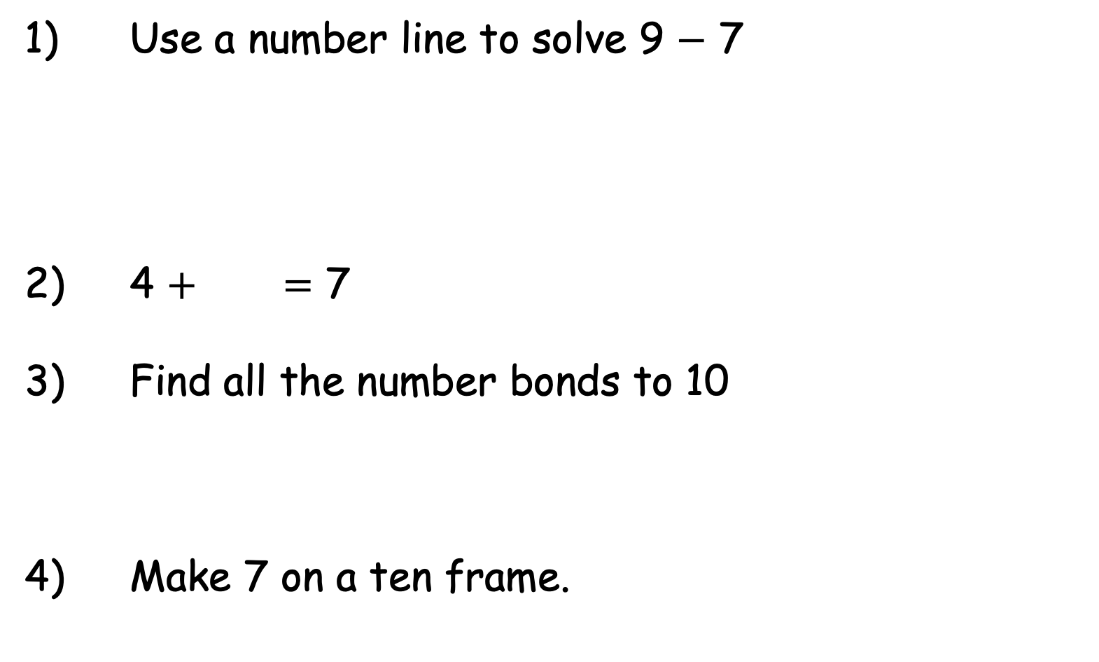
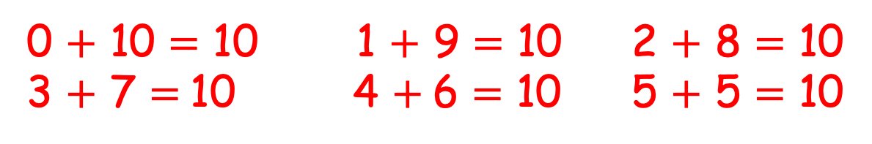
Year 1 | Week 10 | Day 4
1) Use a number line to solve 9 $−$ 7
2) 4 $+$ $=$ 7
3) Find all the number bonds to 10
4) Make 7 on a ten frame.
0
2
9
10
3
0 $+$ 10 $=$ 10 1 $+$ 9 $=$ 10 2 $+$ 8 $=$ 10
3 $+$ 7 $=$10 4 $+$6 $=$ 10 5 $+$ 5 $=$ 10
Or 7 counters in any order.

Slide 49






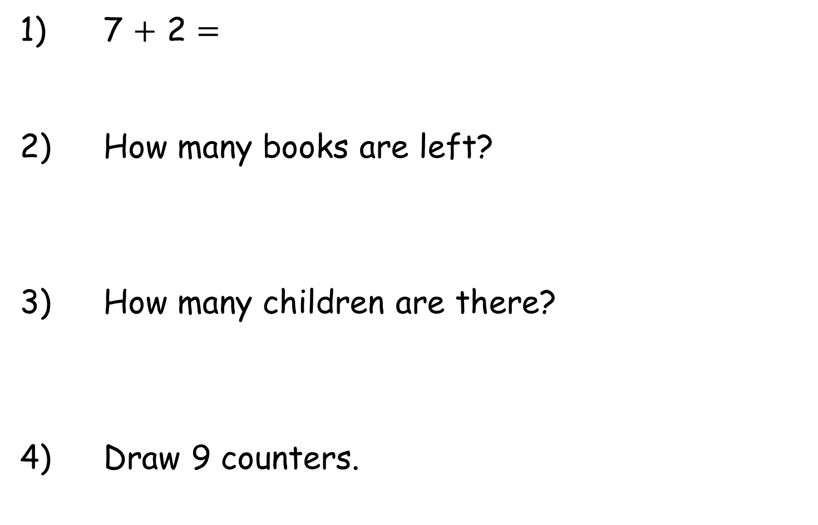
Year 1 | Week 10 | Day 5
1) 7 $+$ 2 $=$
2) How many books are left?
3) How many children are there?
4) Draw 9 counters.

Slide 50
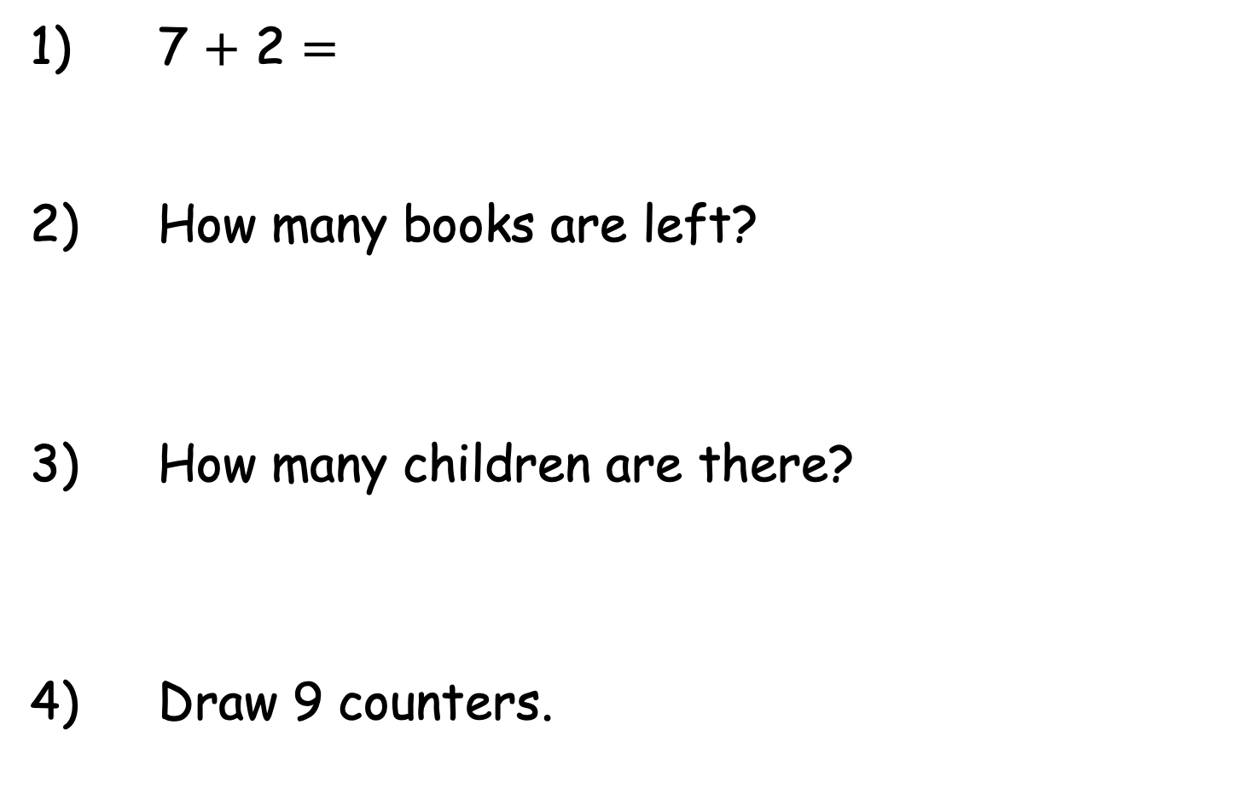
Year 1 | Week 10 | Day 5
1) 7 $+$ 2 $=$
2) How many books are left?
3) How many children are there?
4) Draw 9 counters.
9
3
5

